Slide 1
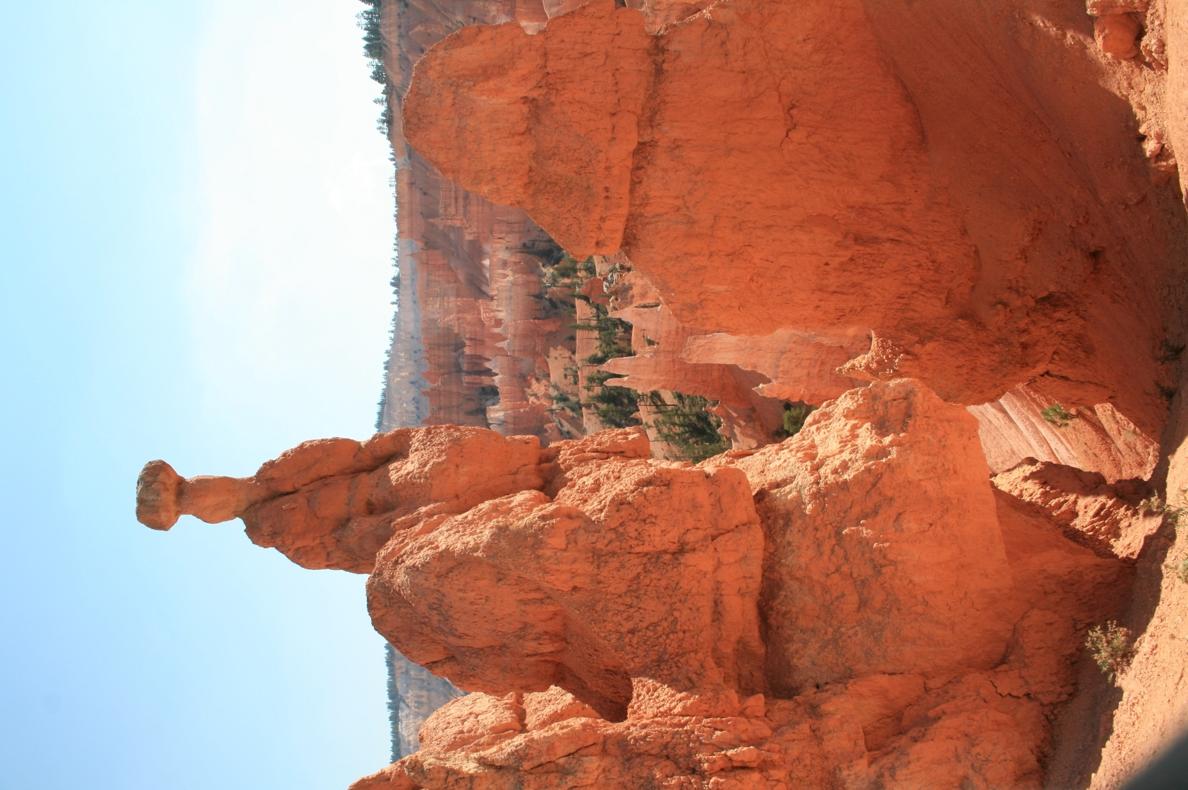
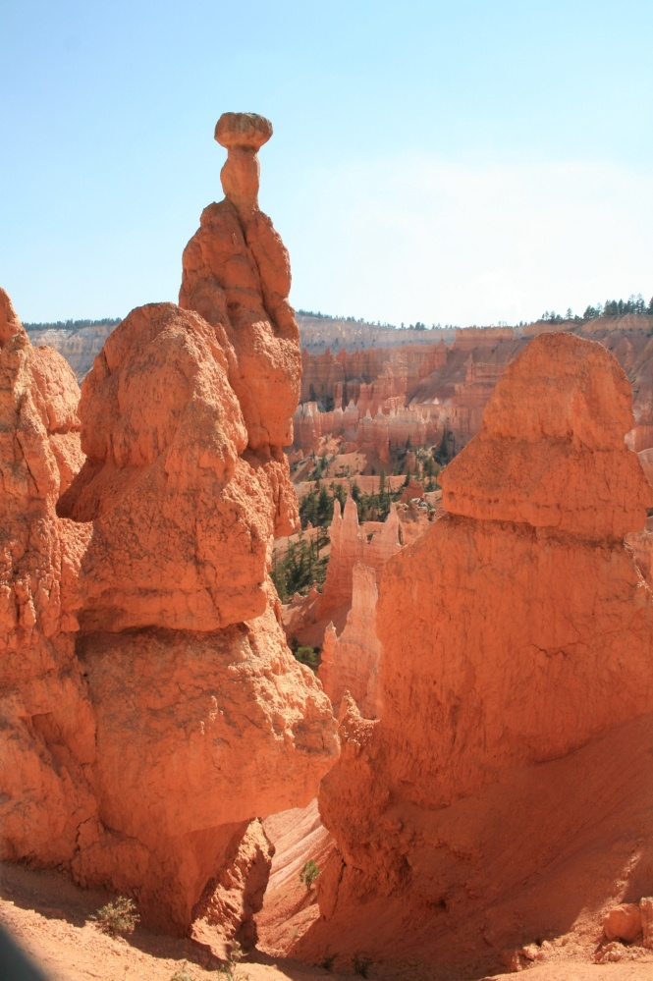
UNIT 1: The properties of matter
1º ESO

Slide 2
Objectives
To know what a physical magnitude is.
To know in which it consists to measure and to understand the necessity of an unit of measurement
To know the units of the international system of length, surface, volume, mass and temperature.
To know how to measure with simple instruments like rulers, scales, thermometers, graduated cylinders.
To know how to pass between the multiples or submultiples of the units of measurement of the magnitudes: length, surface, volume, mass and temperature.
To know that the mass of a system does not change if matter does not enter or leave.
To know that the gases weigh and measure volumes.
To know that the volume of a system does not depend on the state of division nor of its form.
To know that the volume of an object can change without material entering or leaving.
To differentiate between mass and volume.
To know how to calculate the density of an object knowing its mass and volume.
To know how to apply the values of density to decide what bodies float in others.
To know the density is a characteristic property because it allows for identifying substances. It depends on the nature of each substance and not on the amount nor on the form.
To know how to design and to carry out experiments to measure the density of an object.
To know that the temperature informs about the thermal state of objects.
To know that the temperature does not depend on the amount of substance nor on the type of substance.

Slide 3
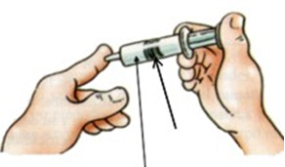
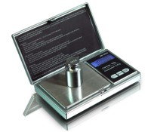
What is matter?
It is any material in the Universe
It has mass and takes up a place in space
It occurs in different physical states, such as solid, liquid or gas
piston
The weight of the drawing has a mass of 100 g
This space is already occupied by air

Slide 4
Properties of matter
Matter has qualities, such as colour, brightness, flavour, smell, hardness, touch, mass, volume….We use them to describe it. All these qualities and other many, are properties of matter
EXTENSIVE PROPERTIES: those properties that depend on the amount of substance.
Mass and volume are extensive properties.
PROPERTIES OF MATTER
INTENSIVE PROPERTIES: those properties that do not depend on the amount of substance.
Colour, brightness, flavour, smell, hardness are intensive properties.

Slide 5
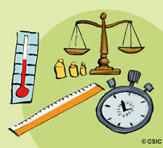
What is measuring?
It is to compare what we want to measure with an amount of that magnitude that we use as a pattern
We need to measure:
A measurement instrument
A comparative pattern
We can measure some properties of matter but not others. Those that we can measure, are quantitative properties. Those that we cannot measure, are qualitative properties.

Slide 6
We call the quantitative properties, physical magnitudes. A physical magnitude is a property that we can measure. Some of these properties are:
Length
Area
Mass
Volume
Density
Temperature

Slide 7
Units of the international system
A system of units is the set of magnitudes and chosen units to measure them.
The system of units more extended all over the world is the international system of units, adopted in the General Conference of Weights and Measures, celebrated in Paris in 1960. Some magnitudes and its units are:
MAGNITUDE | UNIT | SYMBOL
Length | Metre | m
Area | Square metre | m²
Volume | Cubic metre | m³
Mass | Kilogram | kg
Temperature | Kelvin | K
Time | Second | s
Force | Newton | N
Energy | Joule | J
Density | Kilogram/Cubic metre | kg/m³

Slide 8

Length is the distance between two points
LENGTH
The unit of length in the international system of units is the metre (m)
The figure at the right is an equilateral triangle of side 8 cm
The perimeter of a polygon is the sum of its sides, it is a length
The perimeter of this triangle is:
Perimeter = 8 cm + 8cm + 8 cm Perimeter = 24 cm

Slide 9
Multiples and submultiples
of metre
UNIT | SYMBOL | EQUIVALENT
Kilometre | km | 1 km = 1 000 m
Hectometre | hm | 1 hm = 100 m
Decametre | dam | 1 dam = 10 m
Metre | m | 1 m
Decimetre | dm | 1 dm = 0,1 m
Centimetre | cm | 1 cm = 0, 01 m
Millimetre | mm | 1 mm = 0,001 m
km
hm
dam
m
dm
cm
mm
In the stairs of the length, each step is 10 times greater than the inferior immediate step.

Slide 10
AREA
The unit of area in the international system of units is the square metre (m²)
Area is the part of an object that is in contact with the outside
Area = 8 cm x 3 cm = 24 cm²
3 cm
8 cm
We calculate the area of a figure multiplying the width by the length
5cm
A = 5cm x 5cm = 25 cm²

Slide 11
Multiples and submultiples
of square metre
UNIT | SYMBOL | EQUIVALENT
Square kilometre | km² | 1 km² = 1 000 000 m²
Square hectometre | hm² | 1 hm² = 10 000 m²
Square decametre | dam² | 1 dam² = 100 m²
Square metre | m² | 1 m²
Square decimetre | dm² | 1 dm² = 0,01 m²
Square centimetre | cm² | 1 cm² = 0, 000 1 m²
Square millimetre | mm² | 1 mm² = 0,000 001 m²
km²
hm²
dam²
m²
dm²
cm²
mm²
In the stairs of the surface, each step is 100 times greater than the inferior immediate step.

Slide 12
VOLUME
10 cm
The space or place that an object takes up is what we call volume
The unit of volume in the international system of units is the cubic metre
( m³ )
We calculate the volume of this figure as follows:
Volume = wide x high x long
Volume = 10 cm x 10 cm x 10 cm = 1000 cm³
10 cm
10 cm

Slide 13
Multiples and submultiples
of cubic metre
UNIT | SYMBOL | EQUIVALENT
Cubic kilometre | km³ | 1 km³ = 1 000 000 000 m³
Cubic hectometre | hm³ | 1 hm³ = 1 000 000 m³
Cubic decametre | dam³ | 1 dam³ = 1 000 m³
Cubic metre | m³ | 1 m³
Cubic decimetre | dm³ | 1 dm³ = 0, 001 m³
Cubic centimetre | cm³ | 1 cm³ = 0, 000 001 m³
Cubic millimetre | mm³ | 1 mm³ = 0,000 000 001 m³
km³
hm³
dam³
m³
dm³
cm³
mm³
In the stairs of the volume, each step is 1000 times greater than the inferior immediate step.

Slide 14
Other units of volume
In addition to the unit of the international system, the cubic meter, and the multiples and submultiples that you already know, it is very frequent to use other units, like the litre (L), the decilitre (dL), the centilitre (cL) and the milllilitre (mL)
UNIT | SYMBOL | EQUIVALENT
Kilolitre | kL | 1 kL = 1 000 L
Hectolitre | hL | 1 hL = 100 L
Decalitre | daL | 1 daL = 10 L
Litre | L | 1 L = 1 dm³
Decilitre | dL | 1 dL = 0,1 L
Centilitre | cL | 1 cL = 0,01 L
Millilitre | mL | 1 mL = 0,001 L
kL
hL
daL
L
dL
cL
mL
In these stairs, each step is 10 times greater than the inferior immediate step.

Slide 15
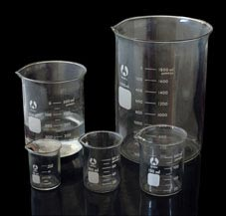
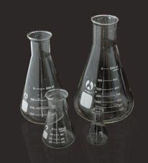
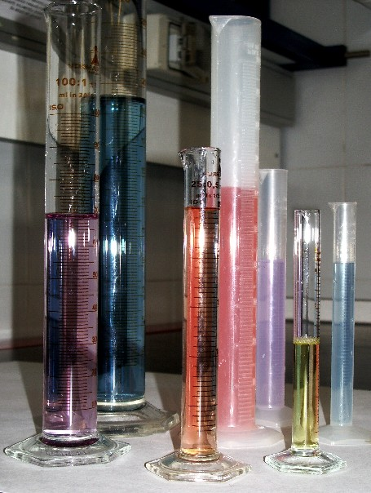
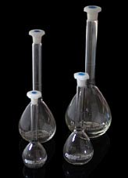
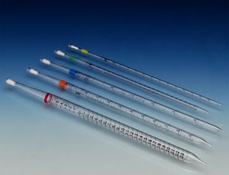
We use different containers to measure the volume of liquids, in a laboratory.
Some of them are the following ones
Beaker
Erlenmeyer flask
Graduated cylinder
Pipette
Volumetric flask

Slide 16

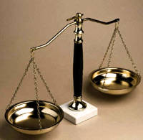
MASS
Mass is the amount of matter that an object has
The air and the other gases have mass and take up a place in space, just as solids and liquids
An object has the same mass in any place
The unit of mass in the international system of units is the kilogram (kg)
We can measure the mass with balances

Slide 17
Submultiples of kilogram
UNIT | SYMBOL | EQUIVALENT
Kilogram | kg | 1 kg
Hectogram | hg | 1 hg = 0,1 kg
Decagram | dag | 1 dag = 0,01 kg
Gram | g | 1 g = 0,001 kg
Decigram | dg | 1 dg = 0,000 1 kg
Centigram | cg | 1 cg = 0, 000 01 kg
Milligram | mg | 1 mg = 0,000 001 kg
kg
hg
dag
g
dg
cg
mg
In the stairs of the mass, each step is 10 times greater than the inferior immediate step.

Slide 18
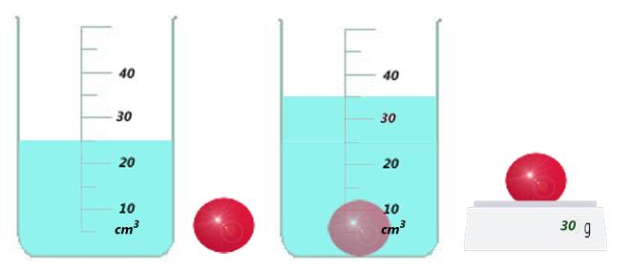
DENSITY
Density is the relationship between the mass of an object and its volume, we represent it by the symbol ( ρ )
The density is a characteristic property because it allows us to identify substances
The mathematical expression of the density is:
If we want to calculate the density of an object, we must calculate its mass and its volume
m
ρ
V
The density of the ball of the figure is:
30 g
ρ
3 g/cm³
10 cm³

Slide 19
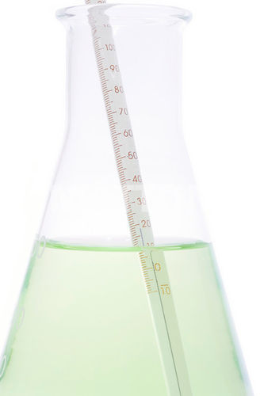
TEMPERATURE
Temperature informs us about the thermal state of objects
The temperature of the objects does not depend on either the type of substance nor the amount of substance
We can measure the temperature of an object with thermometers
The unit of temperature in the international system of units is the Kelvin
In order to transform the degrees Celsius into Kelvin we must add 273
Tª (K) = Tª (⁰C) + 273

Slide 20
MATTER
has
PROPERTIES
that can be
Extensive, depends on the amount of substance
Intensive, does not depend on the amount of substance
Quantitative (measurable)
Qualitative (not measurable)
we call
such as
such as
such as
Physical magnitudes
Flavour
Smell
Softness Beauty Kindnes
Badness Knowledge
Mass
Volume
Density
Temperature
they need
Units of measurement
they give rise
to a
System of units

Slide 21
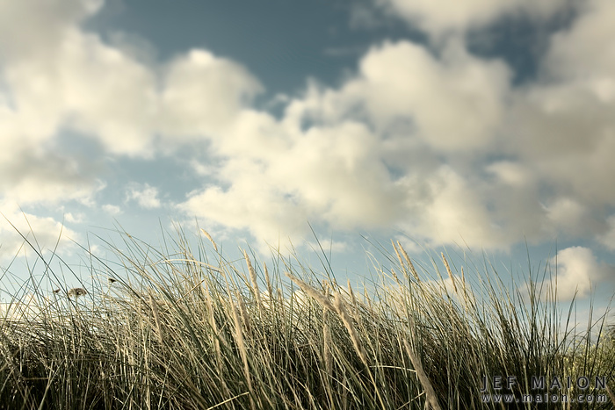
EXERCISE 1
Is the air matter?
No, because it does not weigh anything
Yes, although its weight is zero
No, because we do not see it
Yes, although we cannot see it

Slide 22
EXERCISE 2
Put the following words in order to form a text with sense
space.
Universe
the
and
takes up
in
has
Matter
mass
place
in
is
any material
that
a

Slide 23
EXERCISE 3
Classify the following terms as material or not:
TERMS | YES OR NOT
A roll of film
The temperature of soup
Alcohol
Kindness
Butane gas
Gold
The volume of a table
Smoke
Clouds

Slide 24
EXERCISE 4
Indicate in each case the magnitude (property that we measure), the unit and the amount of the following measures:
MEASUREMENT | MAGNITUDE | UNIT | AMOUNT
15 g
10 m³
14 cm²
1000 L
50 s
100 cm
1,2 g/cm³

Slide 25
EXERCISE 5
What are the decametre, the hectometre and the kilometre?
Multiples of metre
Submultiples of metre
Submultiples of hectare
Submultiples of length
Kilometre | km
Hectometre | hm
Decametre | dam
Metre | m
Decimetre | dm
Centimetre | cm
Millimetre | mm

Slide 26
EXERCISE 6
Complete the chart with the corresponding unit
km | hm | dam | m | dm | cm | mm
0,003
 | 0,2
 |  | 5
 |  |  | 3000
 |  |  |  | 56,8
 |  |  |  |  | 1224,6

Slide 27
EXERCISE 7
Complete the chart with the corresponding unit
km² | hm² | dam² | m² | dm² | cm² | mm²
0,002
 | 0,01
 |  | 3
 |  |  | 4000, 20
 |  |  |  | 200,45
 |  |  |  |  | 6000

Slide 28
EXERCISE 8
Complete the chart with the corresponding unit
km³ | hm³ | dam³ | m³ | dm³ | cm³ | mm³
0,003
 | 0,03
 |  | 0,3
 |  |  | 3
 |  |  |  | 30
 |  |  |  |  | 300

Slide 29
EXERCISE 9
Complete the chart with the corresponding unit
cm³ | dm³ | L | mL
50
 |  | 4,5
 | 3

Slide 30
EXERCISE 10
The mass of an object is 320 g, its area is 80 cm², its volume is 250 cm³, its height is 70 mm and its temperature is 15 ⁰C. Express the previous measures in the units of the international system.
Measurement | Unit of International System
320 g
80 cm²
250 cm³
70 mm
15 ⁰C

Slide 31
EXERCISE 11
What is the area of the figure?
Forty five square metres
Ninety square metres
Nineteen square metres
Forty five cubic metres
9 m
10 m

Slide 32
EXERCISE 12
Calculate the area of the following figure
5 cm
12 cm
Express the result in m² and in mm²

Slide 33
EXERCISE 13
What is the volume of the cube?
A cubic metre
Three cubic metres
A square metre
A litre
1m
1m
1m

Slide 34
EXERCISE 14
Calculate the volume of the figure below
2 cm
Express the result in:
m³
mm³
L
10 cm
4 cm

Slide 35
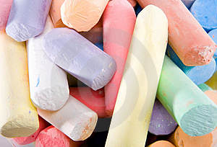
EXERCISE 15
You divide a chalk in pieces of different sizes. Tell if the following affirmations are true or false
The sum of the masses of the different chalk pieces is greater than the mass of the complete chalk
B. The volume of the complete chalk is equal to the sum of the volumes of the chalk pieces
C. The area of the complete chalk is equal to the sum of the areas of the chalk pieces
D. The temperature of a chalk piece is less than the complete chalk

Slide 36
EXERCISE 16
Complete :
In order to find the .................... of a substance, you have to divide its .................... between its....................
Complete the following chart
MASS | VOLUME | DENSITY
35 g | 7 cm³
3000 kg | 0,8 m³
300 g |  | 600 g / L
 | 5 L | 0,9 kg / L

Slide 37
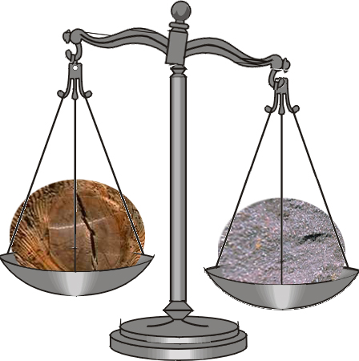
EXERCISE 17
The wood piece and the metal piece are the same size. Why does the piece of metal weigh more?
Because the density of the wood is greater than the density of the metal
Because the metal is less dense than the wood
Because the metal is heavier than the wood
Because the density of the metal is greater than the density of the wood

Slide 38
EXERCISE 18
We have two exactly equal dice, one of silver and another one of gold. We submerge them in two containers that have the same amount of water.
Will the level that the water reaches be the same in both containers? Explain if each of the following expressions are true or false.
No, because both dice have the same volume
Yes, because although they are different substances, they have the same volume
C. It depends on what the containers are like
    D. Yes, because the gold die weighs more
    than the silver one

Slide 39
EXERCISE 19
What is denser, one gram of mercury or one ton of mercury?
What has more mass, one litre of water or one litre of mercury?
One gram of mercury
One ton of mercury
They are the same
One litre of water
One litre of mercury
They are the same
What takes more volume, one litre of water or one litre of mercury?
What is denser, water or mercury?
One litre of water
One litre of mercury
They are the same
Water
Mercury

Slide 40
EXERCISE 20
Revise your vocabulary
Choose a word and fill the blanks below
distance, has, submultiple, magnitude, does, amount , square, depend, space, Kelvin, mass, takes up, volume, area, two, cubic, temperature, kilogram, mass, volume
Matter is all that has .................... and .................... a place in space.
Mass is the .................... of matter that an object ..................... .
Length is the .................... between .................... points.
The .................... that an object takes up is the .................... .
The unit of volume in the international system of units is the .................... metre.
Density is the relationship between the .................... of an object and the .................... it takes up.
The unit of .................... in the international system of units is the .................... metre (m²).
Beauty is not a physical .................... .
Temperature of the objects ……………….. not ……………….. on the amount of substance.
The unit of .................... in the international system of units is the .................... .
The milligram is a ……………….. of the ……………….. .

Slide 41
GLOSSARY
Amount
Area
Balance
Beaker
Characteristic
Container
Cubic meter
Degree
Density
Distance
Energy
Erlenmeyer flask
Force
Gas
Graduated cylinder
International System
Length
Liquid
Litre
Mass
Matter
Metre
Physical magnitude
Pattern
Pipette
Point
Property
Qualitative
Quantitative
Relationship
Set
Solid
Space
Square metre
Submultiples
Substance
Temperature
Thermometer
Time
To allow
To calculate
To classify
To compare
To complete
To describe
To express
To indicate
To measure
To order
To take up
To weigh
Unit
Volume
Volumetric flask

Slide 42
Erlenmeyer flask

Slide 43
Beaker

Slide 44
Volumetric flask

Slide 45
Graduated cylinder

Slide 46
Pipette

