Slide 1
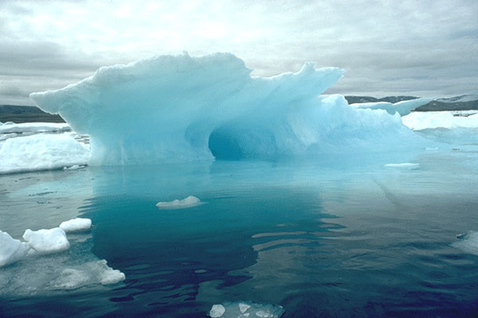
UNIT 2: The physical states of matter
1º ESO

Slide 2
Objectives
To know that in all the states of aggregation the matter has mass and takes a place although depending on the state, can have or not, form and volume fixed.
To know that in principle, any substance can appear in the three states of aggregation.
To know that in the processes of expansion and compression of a gas, the volume of a system changes, but the amount of matter does not change.
To know that the substances in liquid or gaseous state spread with facility.
To know that liquids and solids do not compress practically.
To know the basic hypotheses of the TCM.
To know that the size of molecules is so small that there is no possibility of seeing them with average optician.
To know the differences that exist between the description of systems or processes and their kinetic-molecular interpretation.
To know how to interpret the differences between volume, amount of substance and mass of a gas with the TCM.
To know how to interpret with the TCM processes like the expansion and compression of a gas, the diffusion of a gas or a liquid or the low expansion and compression of a liquid or a solid.
To know how to define basic properties of solids, liquids and gases: hardness, superficial tension, viscosity, ductility, malleability, etc.
To know the names of the changes of aggregation states.
To know how to define the melting and boiling points.
To know how to interpret with the TCM the characteristics of the aggregation states and the changes of state.
To know how to draw molecular diagrams with substances in the three states.
To know how to recognize when a phrase talks about to an observable fact or a theoretical explanation.

Slide 3
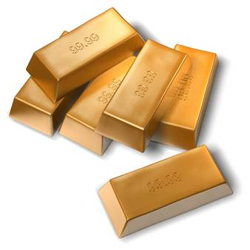
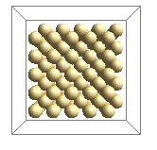
PROPERTIES OF SOLIDS
The properties of solids are:
They have mass
They take up a place in space
They have a definite volume
that does not change
They cannot change their
shape easily

Slide 4
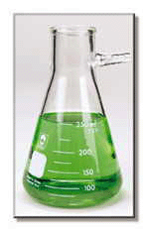
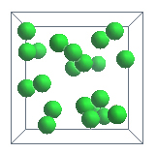
PROPERTIES OF LIQUIDS
The properties of liquids are:
They have mass
They take up a place in space
They have a definite volume
that does not change
They flow
They take the shape
of their container

Slide 5
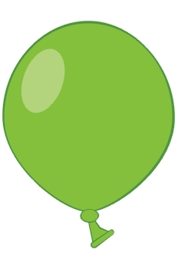
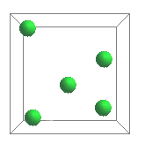
PROPERTIES OF GASES
The properties of gases are:
They have mass
They take up a place in space
They take up all of the available
space
They take the shape of their
container
They mix readily with other
gases
They can compress into a small
space and they can expand

Slide 6
The kinetic-molecular theory
The kinetic-molecular theory is a physical theory that explains the behavior of matter on the basis of the following assumptions:
Any material thing of the universe has a very large number of very tiny
particles called molecules that are in continuous movement
Molecules are not all equal, but they can have form and different
sizes, depending on the type of material
Among molecules there are empty spaces
Solid molecules are close and tidy. They can only vibrate
Liquid molecules are close and untidy. They move relative to each
other
Gas molecules are very distant with respect to their size.
They are in continuous movement
Gas molecules crash into each other and into every object that
surrounds them
The speed of molecules depends on their temperature. It grows when the
temperature increases and it diminishes when the temperature decreases

Slide 7
There are intense attractive forces in solids that hold the molecules together, this is the reason why solids keep their shape and their volume and they can only vibrate
STRUCTURE OF SOLIDS
There are attractive forces in liquids (but less intense than in solids) that hold the liquid molecules together. These attractive forces prevent that the molecules from separating but not from moving relative to each other, this is the reason why liquids keep their volume but do not hold their shape.
STRUCTURE OF LIQUIDS
There are not attractive forces in gases. This is the reason why molecules of gases are very distant, can move freely in any direction and they don't keep their shape, and don't keep their volume either.
STRUCTURE OF GASES

Slide 8
Behavior of substances in gaseous state
Description of the observations | Interpretation according to the molecular kinetic theory
The volume of a gas reduces when we push it from outside. We call this process, compression | In the compression the molecules approach and diminish the medium ranges among them
The volume of a gas increases when it extends through the available space. We call this process, expansion | In the expansion the molecules move away and increase the medium ranges among them
Any gas moves through another gas and it can mix with it. We call this process, diffusion | In the diffusion the molecules move to each other through the empty spaces among molecules of the other gas, mixing themselves

Slide 9
Don´t be confused about this
Molecules are very small, any small piece of matter, has
thousand of millions of molecules
Molecules do not expand or compresse, the molecules
move away or approach
The speed of molecules does not change if the
temperature does not change

Slide 10
Don´t confuse volume of a gas with the amount of substance
Description of the observations | Interpretation according to the molecular kinetic theory
When we move the piston of a syringe inwards or outwards, with a stopper at the end, the volume that takes the air that it contains increases or diminishes respectively. If we have an iron bottle full of oxygen and we inject it with more oxygen, the space that the oxygen takes, does not change but the amount of oxygen changes and so does its mass (weight) | The volume of an object is the space that their molecules take, including the empty space among them. This space can change for a certain number of molecules, being able to be closer or more separated. The amount of substance depends on the number of molecules that form an object. The mass of an object is the sum of the masses each one of its molecules. The mass of a gas only changes when the number of molecules changes.

Slide 11
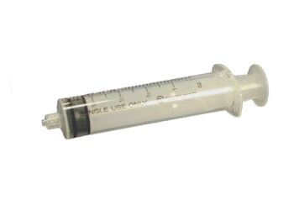
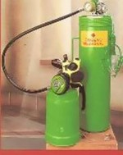
Flexible and rigid containers
syringe
Gases have not own volume; its volume is always that of the container that contains them, because they always take all the available space. For that reason, the changes in the volume of a gas depend on the changes in the volume of the container.
Flexible containers
Rigid container
globe
When the gas is inside a rigid walls container , like a glass or iron bottle, the volume that it takes, cannot change.
When the gas is inside a flexible walls container, as a balloon or a syringe, the volume that the gas takes, can change.
Bottles of oxygen

Slide 12
Behaviour of the substances in liquid and solid states
Description of the observations | Interpretation according to the molecular kinetic theory
Liquids and solids compress in very small proportion | Molecules of solids and liquids are close (although empty spaces exist). If we want to approach them, repulsive forces appear, that prevent their approaching
Solids and liquids practically do not expand and, when they do, it is in very small proportion | In solid and liquid states , the forces among molecules are sufficiently intense to prevent them from separating
Solids do not flow and keep the same shape. Liquids can flow and they do not keep the shape | Molecules of solids only can vibrate. Molecules of liquids can move relative to each other
Some solids present a crystalline structure | Molecules of crystalline solids are tidied following the directions of regular geometric figures. If the molecules of a solid are not in order, we call the solid “amorphous solid”

Slide 13
Some properties of solids
Property | Description
Hardness | It is the ability of a substance to scratch or be scratched. The hardest mineral is the diamond. Hard is the opposite of soft
Fragility | It is the ability to break easily. The diamond is very hard but it is fragile. Fragile is the opposite of strong
Ductility | It is the ability to form wires or filaments.
Malleability | It is the ability to form thin sheets.
Flexibility | It is the ability to deform easily. Flexible is the opposite of rigid
Elasticity | It is the physical property of a material when it is deformed because of stress (external forces), but turns into its original shape when the stress removes. Elastic is the opposite of plastic.

Slide 14
Hardness is one of the physical properties of minerals
Hardness is one measure of the strength of the structure of minerals relative to the strength of its chemical bonds
A hard mineral can scratch a softer mineral, but a soft mineral cannot scratch a harder mineral (no matter how hard you try)
A French mineralogist Friedrich Mohs proposed almost one hundred and seventy years ago, a relative scale to account for the differences in hardness simply by seeing which minerals scratch another
The Mohs Hardness Scale is below
Talc
Gypsum
Calcite
Fluorite
Apatite
Orthoclase
Quartz
Topaz
Corundum (ruby and sapphire)
Diamond
The Mohs Hardness Scale starts with talc at 1 and ends with diamond at 10. The higher the number, the harder the mineral.

Slide 15
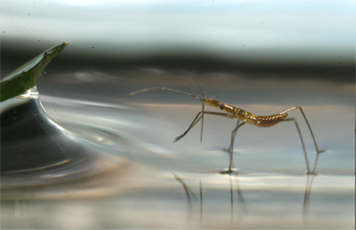
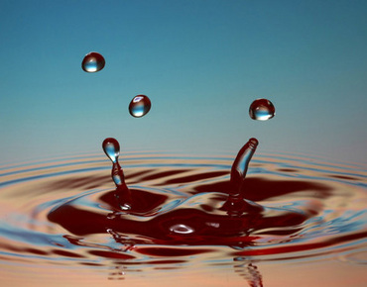
Some properties of liquids
Some properties of liquids are: superficial tension and viscosity
The superficial tension of a liquid is the resistance to the penetration of bodies in it. One of the substances that has greater superficial tension is water. For that reason, it is possible that some insects walk on water. The superficial tension is the cause of the spherical form of the drops of liquids.
Another consequence of the superficial tension is the ascent of liquids within tubes of small diameter.
Viscosity is the resistance of a liquid to flow. Oil is less dense than water because it floats on water but it is more viscous because the oil slides worse on a surface.

Slide 16
Changes of aggregation states
MELTING (FUSION)
SOLID
LIQUID
FREEZING
VAPORIZATION
SUBLIMATION
SUBLIMATION
CONDENSATION
GAS

Slide 17
CHANGE OF STATE | WHAT IS IT?
Melting | It is the change from a solid to a liquid.
Freezing | It is the change from a liquid to a solid.
Vaporization | It is the change from a liquid to a gas, to the temperature of boiling and in all the mass of the liquid.
Evaporation | It is the change from a liquid to a gas, to any temperature and in the surface of the liquid.
Condensation | It is the change from a gas to a liquid.
Sublimation | It is the change from a solid to a gas.
Sublimation | It is the change from a gas to a solid.

Slide 18
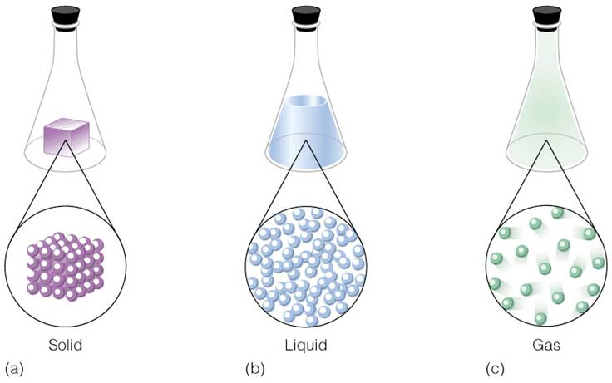
States of matter
Any substance can exist as a solid material, liquid, or gas, depending on the conditions of temperature or pressure.
Matter can change its own state when we heat it or when we cool it.
Solids + energy liquids (Melting)
Liquids + energy gases (Vaporization and Evaporation)
Liquids - energy solids (Freezing)
Gases - energy liquids (Condensation)

Slide 19
As a solid, matter has a fixed volume and shape and is usually unable to flow, except in the case of glaciers.
When we heat the solid state of matter, it turns into a liquid. As a liquid, a substance has a fixed volume, but its shape changes to fill the shape of its container.
The melting point is the constant temperature when a solid turns to a liquid. The melting point of water is 0 °C. The opposite is the freezing point.
The boiling point is the constant temperature when a liquid turns to a gas. The boiling point of water is 100 °C. The opposite is the condensation point.
When we heat the liquid state of matter, it turns into a gas. As a gas, a substance does not have a fixed volume or shape. Gas expands to fill the shape and volume of its container.

Slide 20
Don´t be confused about this
Molecules do not melt, do not solidify, do not change
of volume
Molecules do not boil, do not condense
Molecules move faster or slower
Molecules approach each other or move away

Slide 21
The aggregation states of matter
are
Sublimation
Melting
Vaporization
SOLID
LIQUID
GASEOUS
Freezing
Condensation
has
Sublimation
takes
has
takes
has
takes
a fixed shape
a fixed
volume
the shape of its container
a fixed
volume
the shape of its container
All available
space
has
has
has
molecules which are close and tidy and can only vibrate
molecules which are close and untidy and can move relative to each other
molecules which are very distant and can move freely

Slide 22
EXERCISE 1
Draw particles of a solid and a gas. The particles of the liquid are those of the drawing

Slide 23
EXERCISE 2
Classify the following characteristics into solids, liquids or gases
Definite shape
Changeable volume
Hardness
Molecules close and tidy
Changeable shape
Definite volume
Viscosity
Molecules close and untidy
Changeable shape
Definite volume
Expansion
Molecules distant
SOLID | LIQUID | GAS

Slide 24
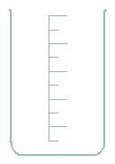
EXERCISE 3
We take a metal cube and we pass it from a container to another, what changes?
The volume of the cube
The shape of the cube
The mass of the cube
Nothing, the cube has the same
volume, mass and shape

Slide 25
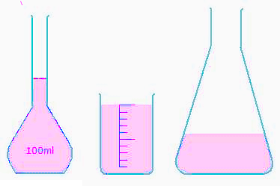
EXERCISE 4
We take a certain amount of liquid and we transfer it from one container to another, what changes?
Density
Shape
Volume
Mass

Slide 26
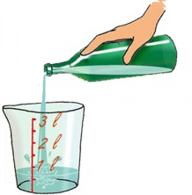
EXERCISE 5
Why can we pour a liquid from one container to another?
Because they have not definite mass
Because their particles are not as strongly united as in a
solid
C. Because they tend to take all the volume
D. Because their particles are as strongly united as in a solid

Slide 27
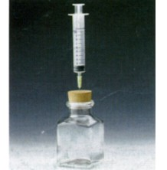
EXERCISE 6
If we inject a certain amount of air into a container, what happens to the mass of that air?
It changes
It does not change
It depends
It changes because the air is in a greater container

Slide 28
EXERCISE 7
If we pass gas from one balloon to another, what happens to its mass?
It depends
It changes because it has a different volume
It changes its shape or volume but not its mass
It changes because it has a different shape

Slide 29
EXERCISE 8
An iron bottle has a capacity of twenty litres. We have it full of oxygen.
If we add two litres of oxygen
What volume takes now the oxygen in the bottle?
Will the bottle weigh more or less?
If we take one litre of oxygen out
What volume takes now the oxygen in the bottle?
Will the bottle weigh more or less?

Slide 30
EXERCISE 9
What happens if we compress a gas too much?
It has a greater volume
B. It has less mass
C. It disappears
D. It turns to liquid state
Normal gas
Compressed gas
Expanded gas

Slide 31
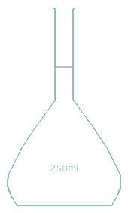
EXERCISE 10
This open container does not contain any liquid, what has in its interior?
Nothing
250 g of air
250 L of air
250 mL of air

Slide 32
EXERCISE 11
Order the following words to form a text with sense
, when they do
and liquids
to prevent
Solids
practically do not expand and
, it is in very small proportion
In solid and liquid states ,
the forces
them from separating
among molecules
are sufficiently intense

Slide 33
EXERCISE 12
Are the following phrases true or false?
Any substance can exist in the three states of matter
If 100 g of a gaseous substance take all the volume of a container, 50 g of that same gas take half of the container
The particles of matter are in continuous movement
When we compress a gas, its particles diminish in size
When we expand a gas, its particles increase in size

Slide 34
EXERCISE 13
Relate the terms of the two columns
Elasticity
Fragility
Ductility
Malleability
Flexibility
Hardness
It is the ability to deform easily.
It is the ability of a substance to scratch or be scratched.
It is the ability to break easily.
It is the ability to form wires or filaments.
It is the ability to form thin sheets.
It is the physical property of a material when it is deformed because of stress (external forces), but turns to its original shape when the stress removes.

Slide 35
EXERCISE 14
Connect the terms of the two columns
Change from solid to gas
B. Change from gas to liquid
C. Change from liquid to solid
Change from solid to liquid
Change from liquid to gas
Melting
Sublimation
Condensation
Vaporization
Freezing

Slide 36
EXERCISE 15
What happens to the water of a pool that disappears?
It disappears
It turns to gas and its particles mix with the particles of air
It is a sublimation
It is a vaporization
Surface of liquid

Slide 37
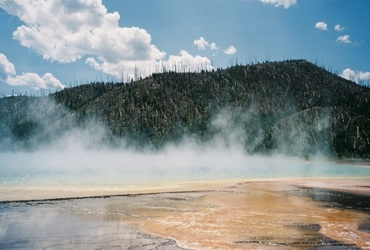
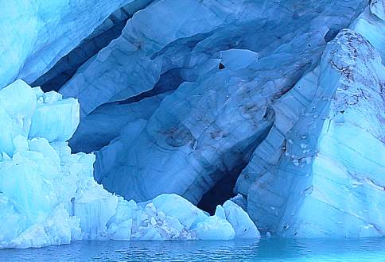
EXERCISE 16
We know that water boils at 100 °C and that ice melts at 0 °C
What temperature does water condense at?
What temperature does water freeze at?

Slide 38
EXERCISE 17
What happens to the particles of subtances with the changes of state?
That the particles become solid, liquid and
gaseous
B. That they become greater or smaller
C. That they separate or they approach
D. Nothing
Which changes of state require cooling to take place?
..................... and .....................

Slide 39
EXERCISE 18
100 g of a liquid substance has a volume of 125 mL. When this substance turns to a solid, it has a volume of 105 mL.
Does the mass of this substance change with this process? Why?
What is the density of this substance in liquid state? And in solid state?

Slide 40
EXERCISE 19
Identify the process that happens
IT HAPPENS | PROCESS
When the mirror of the bath fogs
When liquid water turns to ice
When we see our breath on a cold morning
When we open a bottle of ammonia and we can smell it from a distance
When we heat iron until it turns to liquid
When the water of a pool dries up
The wax of a candle melts
When the lava of a volcano cools and hardens
When we heat water until 100 °C
When we pass a certain amount of gas to a larger container
When we pass a certain amount of gas to a smaller container

Slide 41
EXERCISE 20
Revise your vocabulary
Choose a word and fill the blanks below
softest, ductility, untidy, mixing, hardest, expansion, melting, away, vibrate, close , temperature, boiling, increase, continuous, distant, compression, diffusion, vaporization, malleability
Solid molecules are ……………….. and tidy. They can only ………………..
Liquid molecules are close and ……………….... They move relative to each other.
Gas molecules are very ……………….. with respect to the size of molecules.
They are in ………………. movement.
In the ……………….. molecules approach and diminish the medium ranges among them.
In the ……………….. molecules move ……………….. and ……………….. the medium ranges among them.
In the ……………….. molecules move to each other through the empty spaces among molecules of the other gas, ……………….. themselves
Diamond is the ……………….. mineral. Talc is the ……………….. mineral.
……………….. is the ability to form thin sheets.
……………….. is the ability to form wires.
……………….. is the change from a liquid to a gas, to the temperature of ……………….. and in all the mass of the liquid.
The ……………….. point is the constant ……………….. when a solid turns to a liquid.

Slide 42
GLOSSARY
Attractive
Close
Container
Condensation
Difussion
Ductility
Elastic
Elasticity
Evaporation
Flexibility
Flexible
Force
Fragile
Fragility
Freely
Freezing
Gas
Hard
Hardness
Kinetic
Liquid
Malleability
Melting
Molecule
Particle
Plastic
Rigid
Shape
Soft
Solid
Speed
State of matter
Strong
Sublimation
Tidy
To approach
To compress
To crash
To decrease
To diminish
To expand
To flow
To grow
To hold
To increase
To keep
To mix
To move
To push
To reduce
To vibrate
Untidy
Vaporization
Viscosity

