Slide 1
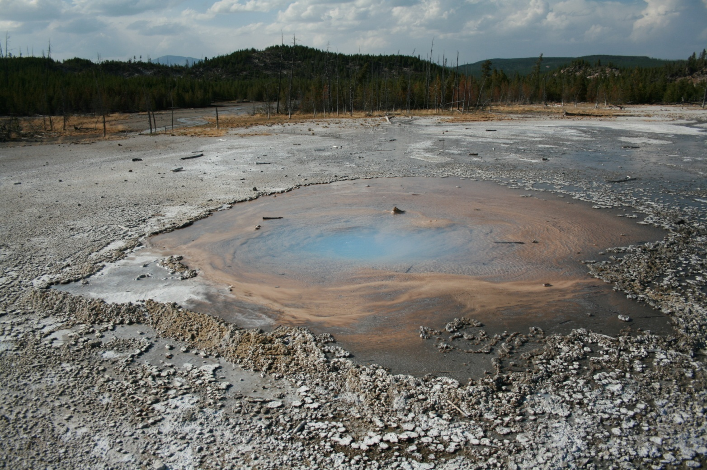
UNIT 3: Pure substances and mixtures
1º ESO

Slide 2
Objectives
To know that a substance is identified according to its characteristic properties like: density and melting or boiling points.
To know the concepts of pure substance, heterogenous mixtures and dissolutions at experimental and theoretical level.
To know that in the dissolution, the dissolved substances are disintegrated at molecular level.
To know the differences between dissolution, dissolvent and solute.
To differentiate between simple substance and compound.
To know how to differentiate between dissolutions and heterogenous mixtures observing its properties.
To know that the properties of the substances at macrocospic level cannot be applied to their molecules.
To know how to draw molecular diagrams that they represent mixtures and pure substances.
To distinguish between the most suitable methods to separate components of homogenous mixtures and those of heterogenous mixtures.
To know how to use techniques of separation like the decantation, the filtration, the distillation, the crystallization or the heating to dryness to separate substances of a mixture.
To know the parts of a distillation, crystallisation and heating equipment.
To know the parts of a decantation and filtration equipment.
To know the composition alloys of common use.
To know the main substances that compose the air, as well as the proportion of
nitrogen and oxygen.
To know the physical properties most important of water.
To know the approximated composition of sea water.

Slide 3
Characteristic properties
A characteristic property is a physical or chemical property that we can use to identify a substance.
Characteristic properties
Density
Melting point
Boiling point
The density is the relationship between the mass of an object and its volume
The temperature at which a substance changes from a solid to a liquid
The temperature at which a substance changes from a liquid to a gas
Mass and volume are not characteristic properties. A small piece of gold has less mass and less volume than a large piece of gold. They depend on the amount of substance.

Slide 4
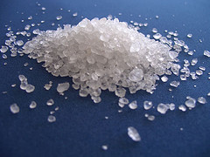
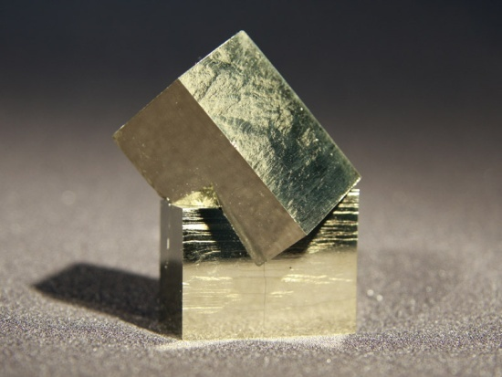
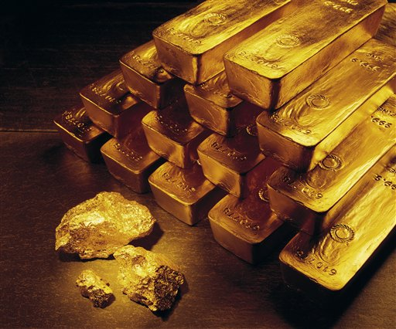
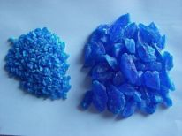
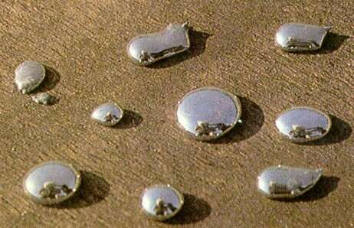
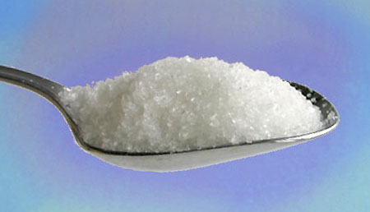
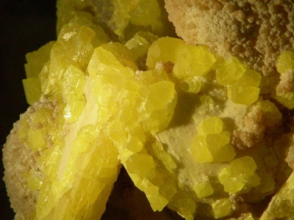
Classification of matter
We can classify matter, in two categories: pure substances and mixtures
Pure substance: only one substance, its characteristic properties do not change, in the same conditions of temperature and pressure
The following systems are pure substances
rock salt
pyrite
gold
copper sulphate
mercury
sugar
sulphur

Slide 5
Types of pure substances
There are two types of pure substances: simple substances and compounds
We can differentiate them, watching their behavior when exposed to heat or electricity.
Simple substances are those which do not decompose into simpler pure substances by means of heating or electrolysis.
Thus oxygen is a simple substance because it does not decompose by means of heating or electrolysis. Gold, mercury and sulphur are simple substances too.
Compounds are those substances that decompose into simpler pure substances by means of heating or electrolysis.
Thus water is a compound because it is decomposed by electricity into two elements, hydrogen and oxygen. Rock salt, pyrite, sugar and copper sulphate are compounds too.

Slide 6
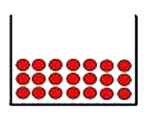
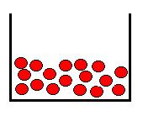
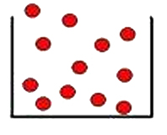
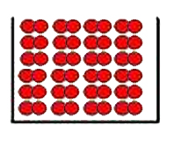
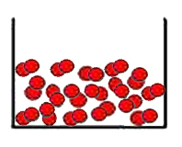
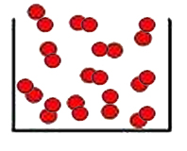
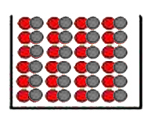
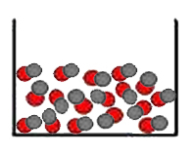
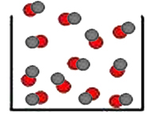
Structure of pure substances
From the point of view of their structure, the pure substances have only one type of molecules.
Simple substances have equal molecules with only one type of atoms
Solid monoatomic
Liquid monoatomic
Gas monoatomic
Solid diatomic
Liquid diatomic
Gas diatomic
Compounds have equal molecules with two or more types of atoms
Solid diatomic
Liquid diatomic
Gas diatomic

Slide 7
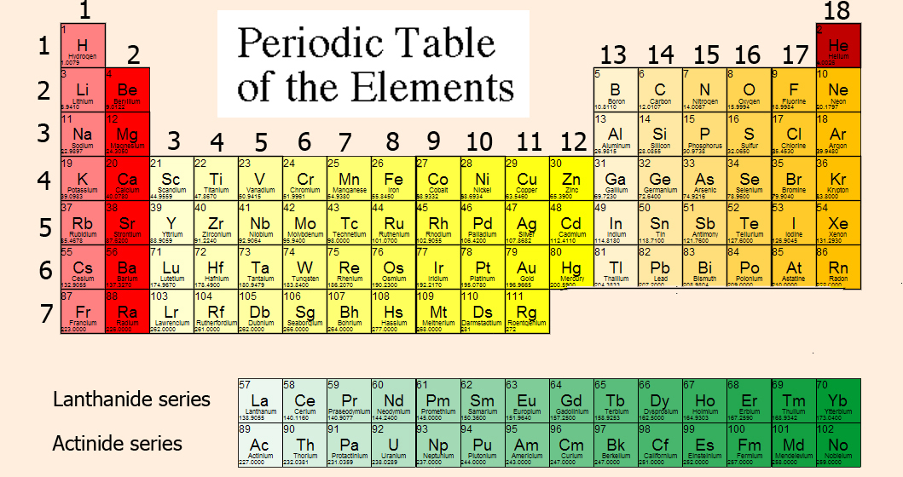
ELEMENTS
Element is the representation of each type of atom, it is not the same as simple substance. An element has not properties, a simple substance has them.
Although only 92 elements occur naturally on earth, they can combine to produce an unlimited number of compounds.

Slide 8
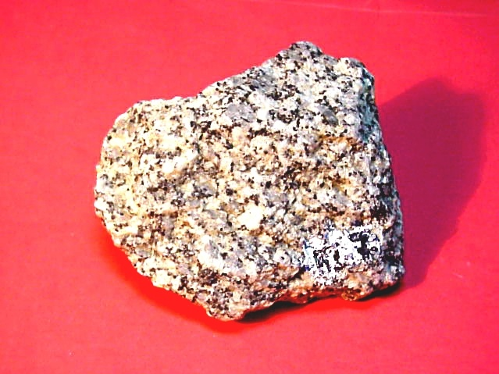
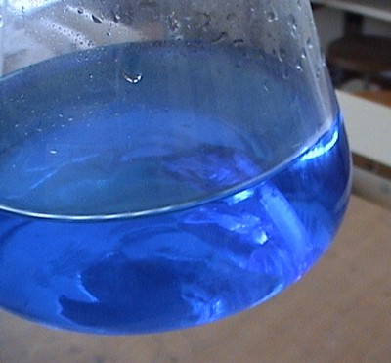
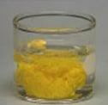
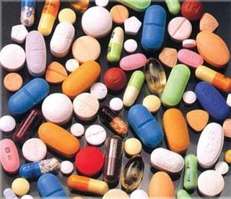
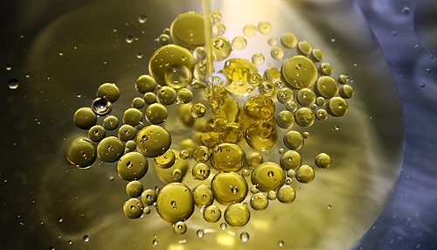
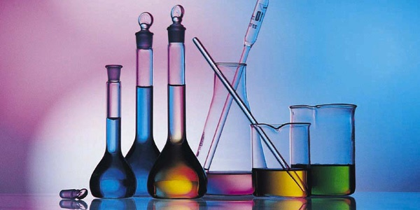
Mixture: two or more substances, its characteristic properties change, depending on the type of substances is formed by and on the amount of each substance
The following systems are mixtures
copper sulphate and water
plumb iodide and
water
granite
oil and water
copper sulphate and water
dissolutions

Slide 9
Types of mixtures
There are two types of mixtures: homogeneous and heterogeneous.
Homogeneous: mixtures which have the same properties throughout the mixture. We can call this type of mixture, dissolution.
For example:
Sugar dissolved in water
Salt dissolved in water
Copper sulphate dissolved in water
Some type of metal alloy like the cromium-molybdenum used in many bike
frames
Heterogeneous: mixtures which have different properties throughout the mixture.
For example:
Sand mixed with water
Oil mixed with water
Granite
Plumb iodide and water

Slide 10
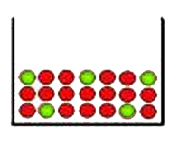
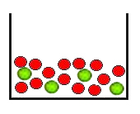
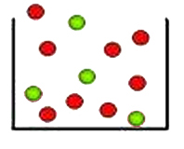
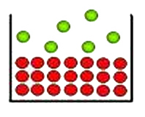
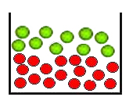
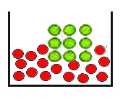
Structure of mixtures
From the point of view of their structure, the mixtures have two or more types of molecules.
Homogeneous mixture: it has different molecules distributed uniformly
Solid dissolution
Liquid dissolution
Gaseous dissolution
Heterogeneous mixture: it has different molecules that are not distributed uniformly
Heterogeneous mixture
of one solid and one gas
Heterogeneous mixture
of two liquids
Heterogeneous mixture of one solid and one liquid

Slide 11
Homogeneous mixtures
Homogeneous mixture: is that has the same properties at all its points
A dissolution (solution) is a homogeneous mixture composed of two or more substances.
When we mix two substances and we obtain a solution, we say that these substances are soluble. A solute is dissolved in another substance, known as a solvent.
Solute is the substance that is in smaller proportion, unless it is water in which case we consider it the dissolvent.
When we mix two substances and we do not obtain a solution, we say that these substances are insoluble.
EXAMPLES OF SOLUTIONS |  | SOLUTE
 |  | GAS | LIQUID | SOLID
SOLVENT | GAS | Air (oxygen and other gases) | Water in air | Naphthalene in air (it sublimes)
 | LIQUID | Carbon dioxide in water | Ethanol in water | Sodium chloride in water, sucrose in water, gold in mercury
 | SOLID | Hydrogen dissolved in metals | Mercury in gold | Steel (metal alloys)

Slide 12
Process of solution
When a dissolution of a solid in a liquid takes place, the molecules of the liquid bang to the solid, pulling molecules away and separating them. Finally, the molecules of the solid remain surrounded by molecules of the liquid and distributed uniformly.
Before dissolving
After dissolving

Slide 13
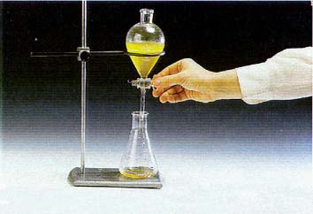
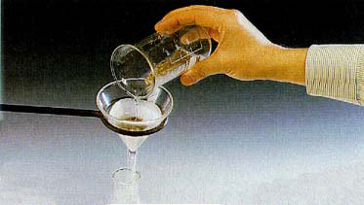
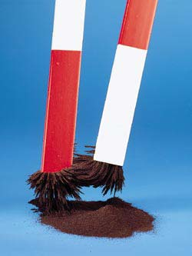
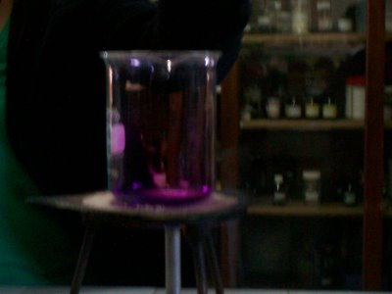
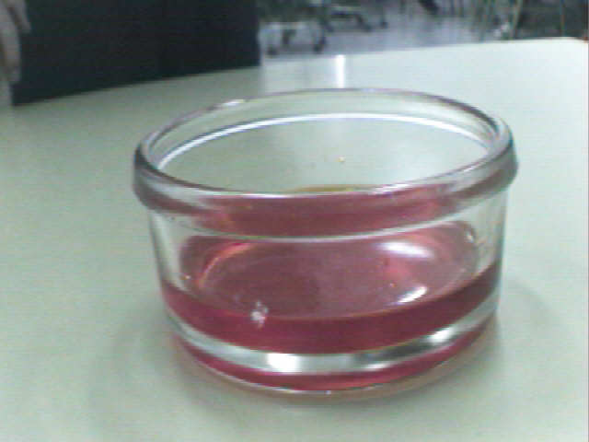
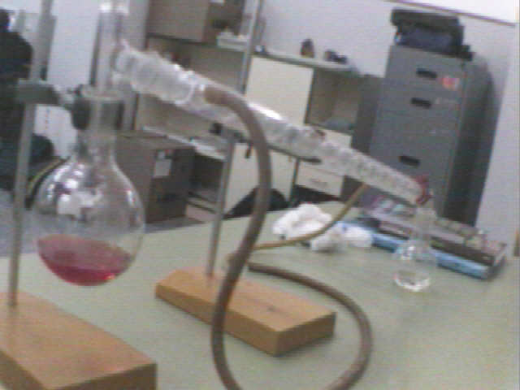
Methods of separation of substances in mixtures
The main techniques of separation of the substances that integrate the heterogeneous mixtures are: decantation, filtration and magnetic separation
The main techniques of separation of the substances that integrate the homogeneous mixtures are: heating to dryness, crystallisation and distillation

Slide 14
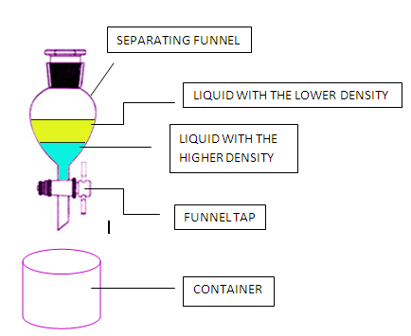
DECANTATION
We use this methode to separate two or more inmiscible liquids with different densities.
We put the mixture into a separating funnel and we allow it to stand for some time. This separates the liquids into layers. The liquid with the lowest density floats on the top and the one with higher density lies below it.
After this, we open the funnel tap and the liquid at the bottom of the funnel is transferred into a container. We do not collect the part of liquid that can contain a small part of the other liquid. After this, we collect the next layer in another container, obtaining two separate liquids.

Slide 15
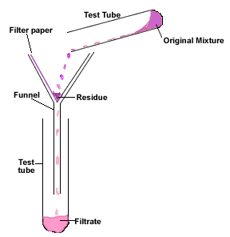
FILTRATION
We use this method to separate an insoluble solid from a liquid. We take a filter paper and fix it to a funnel.
Then, we pour the mixture slowly into a container; through the funnel. We can see the particles of solid on the filter paper. We call residue to the solid particles and we call filtrate to the clear liquid obtained.

Slide 16
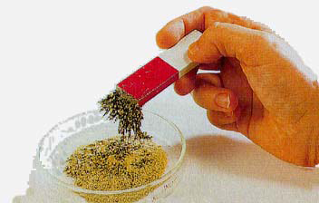
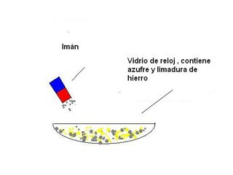
MAGNETIC SEPARATION
We use this methode to separate magnetic solids from non magnetic solids.
Magnet
Sulfur and iron filings
Iron filings are very small pieces of iron that look like a light powder.
Clock glass

Slide 17
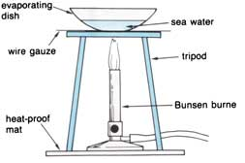
HEATING TO DRYNESS
We use this method to separate soluble solids from solutions. We heat the solution in an evaporating dish until the solvent vaporizes.
When we heat:
We waste energy
Crystals are smaller
The process is faster
In this process we only obtain the solute, not the solvent.

Slide 18
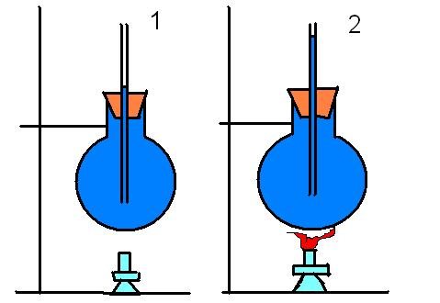
CRYSTALLISATION
We use this method to separate soluble solids from solutions. In this process we must wait for the liquid to evaporate at room temperature without heating it and the solid crystallizes.
In the crystallisation:
We do not waste energy
Crystals are greater
The process is slower
In this process we only obtain the solute, not the solvent.

Slide 19
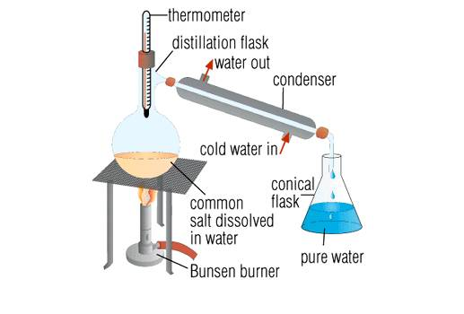
DISTILLATION
We use this method to obtain both the solute and the solvent from a solution. The solute can be a soluble solid or a liquid. We take the solution in a distillation flask and we heat it so that the solvent slowly starts to vaporize. We connect the distillation flask to a condenser tube which has a lower tube for the inlet of cool water and an upper tube for the outlet of water. The circulation of cold water in the condenser helps to cool the gases from the solution and they form the distillate.
We collect the distillate (the solvent) in a separate container. The remaining residue, in the distillation flask, is the solute.
In this process we obtain the solute and the solvent.

Slide 20
MATTER
is classified in
Pure substance
They originate by means of physical procedures
Mixture
Its characteristic properties do not change, in the same conditions of temperature and pressure
Its characteristic properties change, depending on the type of subtances is formed by and on the amount of each substance
can be
can be
These processes give rise
Homogeneous
Heterogeneous
Simple substances
Compounds
Has the same properties at all its points
Has not the same properties at all its points
Equal molecules with only one type of atoms
Equal molecules with two or more type of atoms
To heat
To crystallize
Distillation
Decantation
Filtration
They originate by means of chemical procedures

Slide 21
EXERCISE 1
Indicate which of the following properties are characteristic and which are extensive or intensive.
PROPERTIES | CHARACTERISTIC | INTENSIVE OR EXTENSIVE
MASS
VOLUME
DENSITY
COLOUR
BOILING POINT
LENGTH
HARDNESS
MELTING POINT
SMELL
TEMPERATURE
DUCTILITY
BRIGHTNESS

Slide 22
EXERCISE 2
Connect the terms of the two columns
Granite
Water
Gold
Salt with water
Mercury
Pure substance
Heterogeneous rock
Solution
Liquid metal to room temperature
Solid metal to room temperature

Slide 23
EXERCISE 3
Is the water that we drink an absolutely pure substance?
No, because it is a heterogenous substance
It is not pure, it has mineral salts dissolved
Otherwise, we cannot drink it
Of course, it is distilled water

Slide 24
EXERCISE 4
What do you remember? Separating components of a homogeneous mixtures.
Join with arrows.
By distillation
By crystallisation
By heating
Salt and sea water in the salt mines
Alcohol and water
Copper sulphate and water

Slide 25
EXERCISE 5
What do you remember? Separating components of a heterogeneous mixtures.
Join with arrows.
By magnetism
By filtration
By decanting
Sand and water
Oil and water
Sand and iron particles

Slide 26
EXERCISE 6
Can we decompose a pure substance in others by means of physical procedures?
No, we cannot
Yes, filtering it
Yes, by means of distillation
Clear that yes

Slide 27
EXERCISE 7
Separating mixtures
Complete the sentences. Use the words in the box.
FILTRATION , HEATING, DECANTATION, DISTILLATION
……………………. is good for separating a liquid from a solution.
......................... is good for separating a soluble solid from a liquid.
......................... is good for separating an insoluble solid from a liquid.
......................... is good for separating two inmiscible liquids.

Slide 28
EXERCISE 8
Each verb in the table represents a separation process.
Write down the corresponding noun.
VERB | Evaporate | Distil | Filter | Crystallise
NOUN

Slide 29
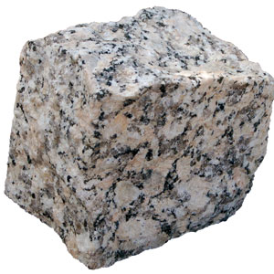
EXERCISE 9
What is the rock called “granite”?
A pure substance and heterogeneous
A homogeneous rock
A pure substance
A heterogeneous solid mixture

Slide 30
EXERCISE 10
Classify the following products as: simple substance, compound, dissolution or mix heterogeneous
PRODUCTS | SIMPLE SUBSTANCE, COMPOUND, DISSOLUTION OR MIX HETEROGENEOUS
Wine
Vinegar
Soft drink
Gasoline
Alcohol 96 %
Marmalade
Milk
Bleach
Bread
Blood
Oil
Iron
Drinkable water
Granite

Slide 31
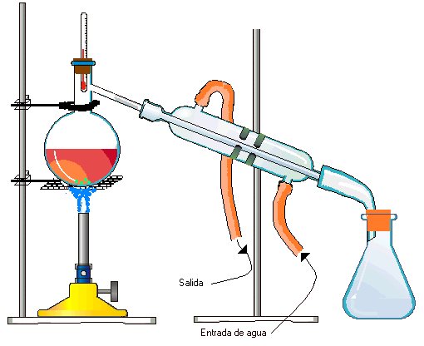
EXERCISE 11
Distillation is the separation of a liquid from a solution by boiling and condensing. Use words from the box to label the diagram:
Thermometer, Cold water out, Vapour, Distillate, Solution, Heat, Cold water in, Condenser

Slide 32
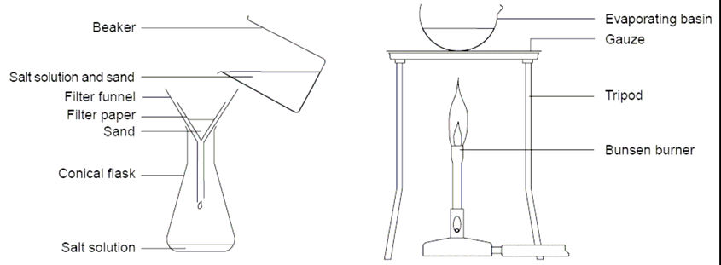
EXERCISE 12
We can heat to separate soluble solids from solutions and we filter to separate insoluble solids from liquids. Use words from the box to label the diagram:
Salt solution, Filter funnel, Filter paper, Sand, Conical flask, Mixture of sand and water, Beaker, Evaporating dish, Gauze, Tripod, Bunsen burner, Water

Slide 33
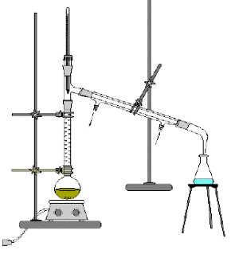
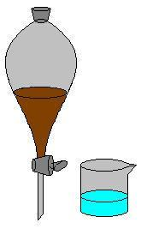
EXERCISE 13
Connect the terms of the two columns
How can you separate oil from water?
How can you separate a mixture of alcohol and water?
How can you obtain salt from sea water?
How can you separate a mixture of sand and stones?
How can you separate a mixture of sulfur and iron filings?
With a magnet
With a separating funnel
With a sieve
Heating until water vaporizes
Distilling

Slide 34
EXERCISE 14
Classify the following systems as: simple substance, compound substance, homogeneous mixtures or heterogeneous mixtures
SYSTEM A
SYSTEM B
SYSTEM C
SYSTEM D

Slide 35
EXERCISE 15
Choose the correct letters in the boxes on the right.
A
B
Mixture of two simple substances
A simple substance with diatomic molecules
Mixture of three simple substances
One compound substance
One simple substance
Mixture of two compounds
A simple substance with monoatomic molecules
C
D
E
F
G
H

Slide 36
EXERCISE 16
Classify the following diagrams as: simple substance, compound, mixture of simple substances, mixture of compounds, mixture of simple substances and compounds.

Slide 37
EXERCISE 17
Which of the following diagrams represent:
The compound CO (gas)
The simple substance O₃ (gas)
The compound H₂O (liquid)
The compound NaCl (solid)

Slide 38
EXERCISE 18
Is the air a pure substance?
No, the air is a gas mixture.
Yes, because it is a gas.
No, because a simple gas form it.
Yes, for that reason we can breathe it.

Slide 39
EXERCISE 19
We add a small amount of a solid substance to a glass with water. After a while, the solid substance disappears and the water is of pink colour.
What is this process called? What tests can you do to verify it?
Indicate which is the solute and which is the solvent.
Make a drawing of how you imagine the molecules of the solid substance and water are, before and later.
What changes occur in the molecules of the solid substance when it disappears in the water?
Why does all the water change colour, although you do not shake with a teaspoon, and not only the part nearest where you put the solid?
A classmate says that the water colours because the molecules of the solid are of pink colour and they mix with those of water that do not have colour. Do you agree? Justify your answer.
A classmate says that if you want to return the water to its original transparent state, you can filter the mixture. Do you agree? Explain your answer.
A classmate says that the pink solid is not the one that you think but another that has the same colour. How can you prove it?

Slide 40
EXERCISE 20
Revise your vocabulary. Choose a word and fill the blanks below
compounds, simple, heterogeneous, atoms, pure substances , decantation, homogeneous, identify, mixtures, distillation, mixtures, physical, pure, crystallisation, change, depending, types, decompose, heating, electrolysis, filtration, dryness, substances, atoms, molecules, compounds, molecules
A characteristic property is a ……………….. or chemical property that we can use to ……………….. a substance.
We can classify matter, in two categories: ……………….. and ………………..
……………….. substances are those which characteristic properties do not ……………….., in the same conditions of temperature and pressure.
In the ……………….., the characteristic properties change, ……………….. on the type of subtances form it and on the amount of each substance.
There are two ……………….. of pure substances: simple substances and ………………..
……………….. substances are those which do not ……………….. into simpler pure substances by means of ………………. or ……………… .
Simple .................... have equal ……………….. with only one type of ……………….. .
……………….. have equal ……………….. with two or more types of ……………….. .
There are two types of mixtures: ………………. and ……………….. .
The main techniques of separation of heterogeneous mixtures are: the ……………….., the ……………….. and the magnetic separation.
The main techniques of separation of homogeneous mixtures are: the heating until ……………….., the ……………….. and the ……………….. .

Slide 41
GLOSSARY
Alloy
Atom
Bunsen burner
Clock glass
Condenser
Container
Compound
Crystallisation
Decantation
Dissolution
Distillation
Distillation flask
Electrolysis
Element
Evaporating dish
Filtration
Frame
Funnel
Filter paper
Heterogeneous mixture
Homogeneous mixture
Insoluble
Layer
Magnet
Magnetic separation
Mixture
Pressure
Pure substance
Residue
Separating funnel
Simple substance
Soluble
Solute
Solution
Solvent
Structure
Test tube
To bang
To collect
To decompose
To dissolve
To distribute
To filter
To float
To give rise to
To heat
To identify
To pull away
To remain
To shake
To surround
To transfer
Tripod
Wire gauze

