Slide 1
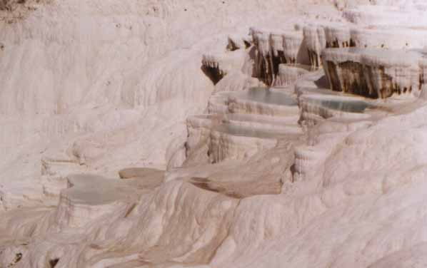
UNIT 4: Chemical and physical changes
1º ESO

Slide 2
Objectives
To know the basic characteristics of chemical reactions.
To know the differences between physical changes and chemical changes.
To know how to classify processes as chemical or physical changes according to wether characteristic properties of the substances vary or not.
To know the concepts of simple substance and compound.
To know of what the processes of thermal decomposition and electrolysis consist.
To be able to identify a simple substance or a compound according to wether it decomposes or not.
To know the hypotheses of the atomic theory.
To know what is a symbol and the meaning of a formula.
To know the name and the symbols of the most common elements.
To know the theoretical concept of chemical reaction.
To know the basic physical and chemical properties of hydrogen, oxygen and carbon dioxide.
To know how to recognize hydrogen, oxygen and carbon dioxide in a laboratory.
To know the characteristics of combustion reactions.
To draw molecular diagrams of substances from the knowledge of its formulas and their state of aggregation.
To draw atomic-molecular diagrams that represent a chemical reaction.
To differentiate between the observed facts and the theoretical explanations for them.

Slide 3
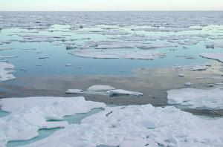
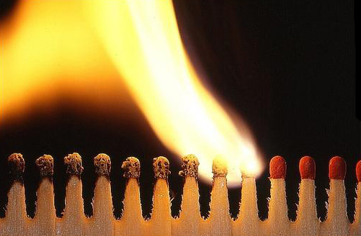
Physical changes and chemical changes
Matter can undergo transformations that can be physical or chemical
Physical changes: those in which the substances continue being the same ones
The changes of state and the processes of dissolution of the substances are physical changes
Chemical changes: those in which the substances that there are at the beginning disappear and in their place appear new ones
The chemical changes are called chemical reactions
The combustions are chemical changes

Slide 4
Recognition of a chemical reaction
What happens when a chemical reaction occurs?
We say that a change that has happened to the matter is a chemical transformation or chemical reaction if substances disappear and new ones appear.
In order to verify if the obtained substances are the same as those at first we must analyze the characteristic properties. If the values of the characteristic properties are different, it is a chemical change. In another words, in a chemical reaction, the composition of the substance changes.
H₂ (g) + O₂ (g) → H₂O (l)
We represent a chemical reaction by means of a chemical equation. On the left we write the initial substances, which are called reactants, and on the right the final substances, called products. Next to the formula of each substance we write, between parenthesis, the aggregation state.
The substances produced during chemical changes cannot easily change back into the original substances however in physical changes, the substances produced are easily reversed

Slide 5
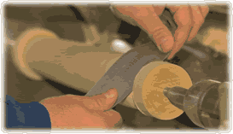
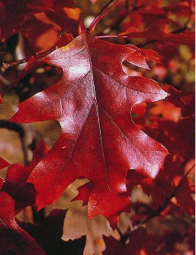
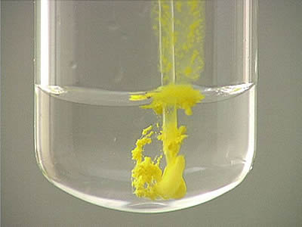
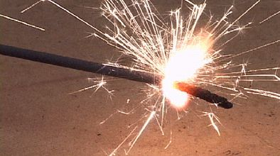
Signs of chemical changes
The following can indicate that a chemical change has taken place, although this evidence is not conclusive:
Change of colour (for example, iron rusts)
Change in temperature or energy, such as the production or loss of heat.
Change of form (for example, burning paper).
Light, heat, or sound is given off.
Formation of gases, often appearing as bubbles.
Formation of precipitate (insoluble solid).
The decomposition of organic matter (for example, rotting food).

Slide 6
Decomposition of substances
When we warm a substance up and it disappears and new ones appear, it is a chemical reaction called thermal decomposition.
When we pass an electrical current through a substance and this one disappears and other new ones appear, is a chemical reaction called electrical decomposition or simply, electrolysis.
In most of the occasions in which we warm a substance up or we made to pass an electrical current through a substance, this one disappears and other new ones appear, In few substances, however, even though a current electrical passes through them or they are warmed up at very high temperatures, these substances continue being the same ones.

Slide 7
Compounds and simple substances
We saw in the previous unit that:
Simple substance: is that which does not disappear and does not give rise to other different ones by heating or electrolysis.
Compound substance: is which disappears and gives rise to other different ones by heating or electrolysis.
Sugar, water, sodium chloride and calcium carbonate are compounds
Water, for example, decomposes into hydrogen and oxygen when exposed to an electric current.
H₂O H₂ + O₂
A common agent of decomposition in chemistry is heat, for example, calcium carbonate decomposes into calcium oxide and carbon dioxide when exposed to heat.
Electrolysis
Heating
CaCO₃ CaO + CO₂
Mercury, oxygen, helium and gold are simple substances
Electrolysis
Heating
O₂
O₂
O₂
O₂

Slide 8
Hypothesis of the molecular atomic theory of Dalton
The molecules of the substances are formed by other smaller particles called atoms
In order to explain the structure of the substances that exist in the nature, the scientists suppose that 90 atom classes exist. We call each type of atom an element (to each atom class).
When a substance is a simple substance, all the atoms that form their molecules are equal. When a substance is a compound, their molecules are formed by at least two atom classes.

Slide 9
Elements and formulas
Each element is represented by a symbol, that is a capital letter, or two letters, the first capital letter and the second a lowercase letter
In order to represent the substances, we use formulas. In the formulas, we write the symbols of the atoms that form the molecule and numbers like subscripts that they indicate how many atoms of that class there are in each molecule.
Substance Name and formula | Meaning of the formula | Drawing of the molecule
Iron, Fe | The iron molecules are formed by an iron atom
Oxygen, O₂ | The oxygen molecules are formed by two oxygen atoms
Carbon dioxide, CO₂ | The carbon dioxide molecules are formed by the union of a carbon atom and two oxygen atoms
Water, H₂O | The water molecules are formed by the union of an oxygen atom and two hydrogen atoms

Slide 10
Classification of some substances as simple or compound knowing their formulas
Substance Name and formula | Type of atoms | Simple substance or compound
Mercury, Hg | One type: Hg | Simple substance
Sugar, C₁₂H₂₂O₁₁ | Three types: C, H y O | Compound
Sodium chloride, NaCl | Two types: Na y Cl | Compound
Oxygen, O₂ | One type: O | Simple substance
Water, H₂O | Two types: H y O | Compound
Butane, C₄H₁₀ | Two types: C y H | Compound
Calcium oxide, CaO | Two types: Ca y O | Compound
Helium, He | One type: He | Simple substance

Slide 11
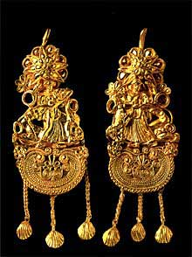
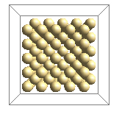
Don´t be confused about this
Atoms and molecules are concepts that the scientists invent to explain the properties of the substances. Atoms and molecules have not properties.
The gold atom is not solid, neither liquid, has not melting point, has not color. The scientists only assign them properties like the mass, the volume or the movement.
A substance such as gold is something observable, formed by many atoms of gold, solid at room temperature and with a high melting point.
Simple substance: gold
Gold earrings
Gold atom

Slide 12
Don´t be confused about this
It is not the same simple substance that element.
It is easy to confuse them because the name of the simple substance agrees with the name of the atom class.
Element is the representation of each type of atom.
An element has not properties, a simple substance has them.

Slide 13
A model to explain the chemical reactions
In physical changes, molecules do not change because substances continue being the same ones.
The molecular kinetic theory explains the physical changes supposing that molecules move more or less quickly and they come close together or move away.
In chemical reactions, molecules change because some substances disappear and other new ones appear.
The molecular kinetic theory explains chemical changes supposing that molecules break when they hit to each other and the resulting atoms combine forming other molecules.
Molecules are made of atoms of different elements that are held together by chemical bonds. In chemical reactions, molecules change by breaking and forming chemical bonds.
The molecules break if they fulfill the following conditions:
That the shock is sufficiently strong
That the shock takes place with the
suitable direction

Slide 14
Representation of chemical reactions
In this activity animations will represent what happens to the bonds between the atoms during a chemical reaction.
Chemical change
The molecules are the same
Atom of oxygen
The atoms are the same but not the molecules
Physical change
Atom of hydrogen

Slide 15
Characteristics properties of some gases as: oxygen, hydrogen and carbon dioxide
 | Melting point (ºC) | Boiling point (ºC) | Density (g/L) | Chemistry property
Oxygen | -219 | -183 | 1,43 | It is necessary for the combustion of the substances.
Hydrogen | -259 | -253 | 0,09 | It burns in the presence of oxygen forming water.
Carbon dioxide | The solid sublimes directly to a gas above -78 ⁰C |  | 1,96 | It is obtained in the combustions and in the breathing.
 | How can we recognize it?
Oxygen | If we have a container with oxygen and we introduce a wood piece burning weakly, we observe that the flame is intensified and the wood piece burns more quickly
Hydrogen | If we put an ignited match into a container with hydrogen, when the hydrogen makes contact with the oxygen of the air, it explodes and it forms water
Carbon dioxide | If we have a container with carbon dioxide and we introduce any burning mass, it is extinguished immediately. If we make carbon dioxide bubble through a dissolution of calcium hidroxide in water, the dissolution becomes cloudy quickly because a new substance forms, insoluble in water, of white colour, called calcium carbonate.

Slide 16
Pure substance
Its characteristic properties do not change, in the same conditions of temperature and pressure
can be
Simple substances
Compounds
is which does not disappear and does not give rise to other different ones by heating or electrolysis
is which disappears and gives rise to other different ones by heating or electrolysis
Equal molecules with only one type of atom
Equal molecules with two or more types of atoms
They originate by means of chemical procedures

Slide 17
EXERCISE 1
Classify the following processes as physical or chemical transformations. Explain your answer.
We cook an egg for three minutes.
We compress the air that there is within a syringe.
We burn wood to warm us up.
We tear up a piece of paper.
Digestion of food.
We dissolve a spoon of salt in a beaker of water.
We burn a small piece of torn up paper.
We pour a small amount of the salt water into another beaker and heat it until the water vaporizes and the salt appears.
The bodywork oxidizes.
We cut a copper wire
A perfume bottle evaporates.
We mix water and sugar.
Old leaves decompose.
We paint wood.
Ice melts.

Slide 18
EXERCISE 2
We know that the liquid contained in a glass is a pure substance whose density is 0,9 g/cm³ . We warm it up and we let it cool verifying that the density is now of 1 g/cm³
Is the obtained liquid the same substance of the beginning? Why?
Is a physical or chemical change? Why?

Slide 19
EXERCISE 3
Draw a molecule of the following substances knowing the formula.
Substance | Drawing
Mercury, Hg
Carbon monoxide, CO
Sodium chloride, NaCl
Hydrogen, H₂
Copper sulphate, CuSO₄
Butane, C₄H₁₀
Calcium oxide, CaO
Helium, He
Ammonia, NH₃
Methane, CH₄
Nitrogen, N₂
Ethanol, C₂H₆O

Slide 20
EXERCISE 4
Indicate the formula of the following substances from the drawing of one of its molecules.
Ca
O
Hg
Cl
C
S
H
P
MOLECULE | FORMULA

Slide 21
EXERCISE 5
The following two diagrams show a molecule of a simple substance and a molecule of a compound.
The diagram A shows ……………………………………………….
because there is more than one type of …………………………..
2. The diagram B shows ………………………………………………
because there is one type of ………………………………………
A.
B.

Slide 22
EXERCISE 6
Indicate if the following substances are simple substances or compounds. Explain your answer.
Substance | Simple or compound
Mercury, Hg
Carbon monoxide, CO
Sodium chloride, NaCl
Hydrogen, H₂
Copper sulphate, CuSO₄
Butane, C₄H₁₀
Calcium oxide, CaO
Helium, He
Ammonia, NH₃
Methane, CH₄
Nitrogen, N₂
Ethanol, C₂H₆O

Slide 23
EXERCISE 7
Using the symbols that are indicated, draw in your notebook how you imagine the following substances.
The simple substance mercury (Hg), liquid at room temperature
The simple substance chlorine (Cl₂), gas at room temperature
Hg
Cl
The compound carbon disulfide (CS₂), liquid at room temperature
The compound calcium oxide (CaO), solid at room temperature
C
S
Ca
O

Slide 24
EXERCISE 8
Are the following phrases true or false?
In a chemical reaction, the molecules of the reactants do not change but they mix with each other.
In a chemical reaction, the molecules of the reactants disappear and they do not become anything.
In a chemical reaction, the molecules of the reactants continue being the same ones but in another state.
In a chemical reaction, the molecules of the reactants disappear and other new ones appear.

Slide 25
EXERCISE 9
The calcium carbonate (CaCO₃), is a solid substance at room temperature. If we warm it up sufficiently, it disappears and it gives rise to two substances, the calcium oxide (CaO), that is solid at room temperature and the carbon dioxide (CO₂) that is gas at that temperature.
Draw how you imagine what it happens to the molecules in that process.
Is a physical or chemical change? Explain your answer.
Is a simple substance or a compound? Explain the answer with arguments based on the molecular atomic theory.
+
CaCO₃
CaO
CO₂

Slide 26
EXERCISE 10
Iron (Fe) is a solid substance at room temperature, which can react with the oxygen (O₂), substance that appears in gaseous state at room temperature, to make iron oxide (FeO), solid substance at room temperature.
Draw how you imagine the molecular atomic structure of the iron and the oxygen before the reaction and formed iron oxide.
How is possible that we obtain a solid substance from a solid substance and another one gaseous?
If we write the chemical reaction of the previous process of the following form:
Is this correct? Explain your answer.
+
Fe
O₂
FeO
Fe + O₂ FeC

Slide 27
EXERCISE 11
If we warm the solid iron up until the temperature of 1808 K turns to a liquid, when we cool it below that temperature it returns to solid state with the same aspect of the iron.
Is this a physical or chemical process? Explain your answer.
Draw how you would imagine the changes produced in the iron when we warm it up.
Fe (solid)
Fe (liquid)

Slide 28
EXERCISE 12
Connect the terms of the two columns
A pure substance formed by molecules of an atom.
A pure substance, three molecules of a compound.
Four different chemical elements.
A pure substance, four molecules of a simple substance.
1.
2.
3.
4.

Slide 29
EXERCISE 13
Are the following phrases true or false?
Sulphur is a simple substance of yellow colour, therefore, sulfur atoms are yellow.
In a physical change, the molecules disappear and other new ones appear.
In a chemical change the new substances have properties different from the initial substances.
The compounds disappear and give rise to other substances by physical procedures.
An element is just like simple substance.
The water molecules are liquid.

Slide 30
EXERCISE 14
The following drawings represent different gaseous systems. The symbols and represent different atoms:
A
B
Classify each one of the diagrams as simple substance, compound or mixture. Explain your answer.
If we cool the system A until it turns to liquid, will we obtain one or more substances? Explain the answer. Is it a physical or chemical process? Explain your answer.
If we cool the system B until it turns to liquid, will we obtain one or more substances? Explain the answer. Is it a physical or chemical process? Explain your answer.

Slide 31
EXERCISE 15
The figure A represents the atomic-molecular structure of a system. After warming it up and letting it cool, the resulting system has the atomic-molecular structure indicated in figure B. According to these atomic-molecular diagrams, is it a physical change or a chemical change? Explain your answer.
A
B

Slide 32
EXERCISE 16
Classify each one of the diagrams as a simple substance, compound, homogeneous mixture or heterogeneous mixture. Explain your answer.
A
B
C
D
E
F

Slide 33
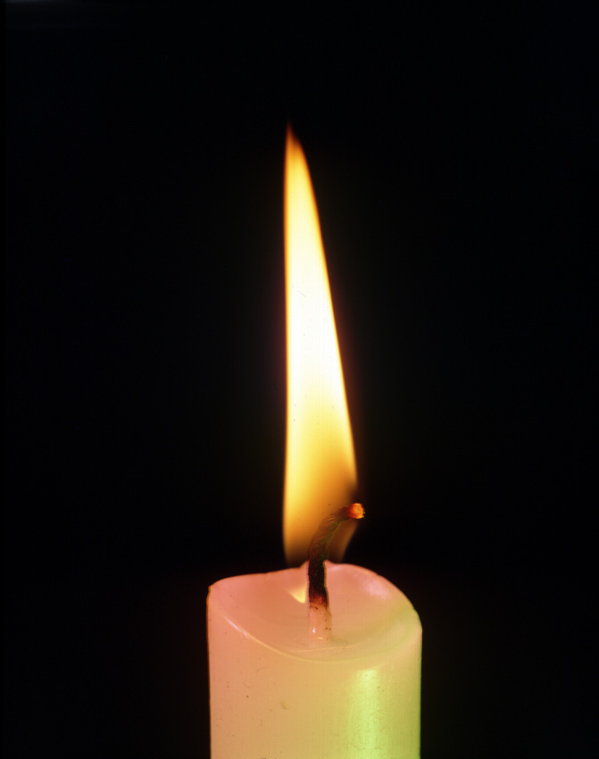
EXERCISE 17
What gas is necessary for combustion to occur?
Hydrogen
Carbon dioxide
Helium
Oxygen

Slide 34
EXERCISE 18
Answer considering the information of the table.
Gas | Density (g/L)
Oxygen | 1,43
Hydrogen | 0,09
Carbon dioxide | 1,96
If we fill three balloons, one with oxygen, another one with hydrogen and another one with carbon dioxide:
Which one will rise more?
Which one will rise less?

Slide 35
EXERCISE 19
Connect the terms of the two columns
Oxygen
Hydrogen
Carbon dioxide
This gas becomes cloudy quickly from a dissolution of calcium hidroxide.
This gas intensifies the flame of something that is burning.
When this gas makes contact with the oxygen of the air, it explodes and it forms water.

Slide 36
EXERCISE 20
Revise your vocabulary. Choose a word and fill the blanks below.
being, atom, simple, physical, compound, electrolysis, disappear, changes, substances, reactions, chemical, simple, does, heating, electrolysis, properties, compound, gives rise, heating, least, molecules, classes, kinetic, supposing, break, forming, properties, concepts, scientists, atoms.
……………. changes are those in which the substances continue ............... the same ones.
Chemical ……………….. are those in which the ……………….. that there are at the beginning ……………….. and in their place new ones appear.
The ……………….. changes are called chemical ……………….. .
Pure substances can be: ……………….. substances and ……………….. .
……………….. substance is which ……………….. not disappear and does not give rise to other different ones by ……………….. or ……………….. .
……………….. substance is which disappears and ……………….. other different ones by ……………….. or ……………….. .
In a simple substance, all the ……………….. that form their molecules are equal.
In a compound, the ……………….. are formed by at ……………….. two atom ……………….. .
An element has not ……………….. , a simple substance has them.
Atoms and molecules are ……………….. that the ……………….. invent to explain the ……………….. of the substances. ……………….. and molecules have not properties.
The molecular ……………….. theory explains chemical changes ……………….. that molecules ……………….. when they hit to each other and the resulting atoms combine ……………….. other molecules.

Slide 37
GLOSSARY
Bubble
Calcium hidroxide
Carbon dioxide
Chemical
Combustion
Composition
Current
Decomposition
Electrical
Electrolysis
Element
Equation
Flame
Formula
Helium
Hydrogen
Hypothesis
Kinetic
Molecular
Oxygen
Physical
Precipitate
Process
Product
Reactant
Reaction
Recognition
Symbol
Sulphur
Theory
Thermal
To analyze
To appear
To assign
To burn
To classify
To cool
To disappear
To explode
To expose
To fill
To fulfill
To hit
To imagine
To intensify
To occur
To oxidize
To rise
To shock
To undergo
To verify
To warm
Sign
Values

