Slide 1
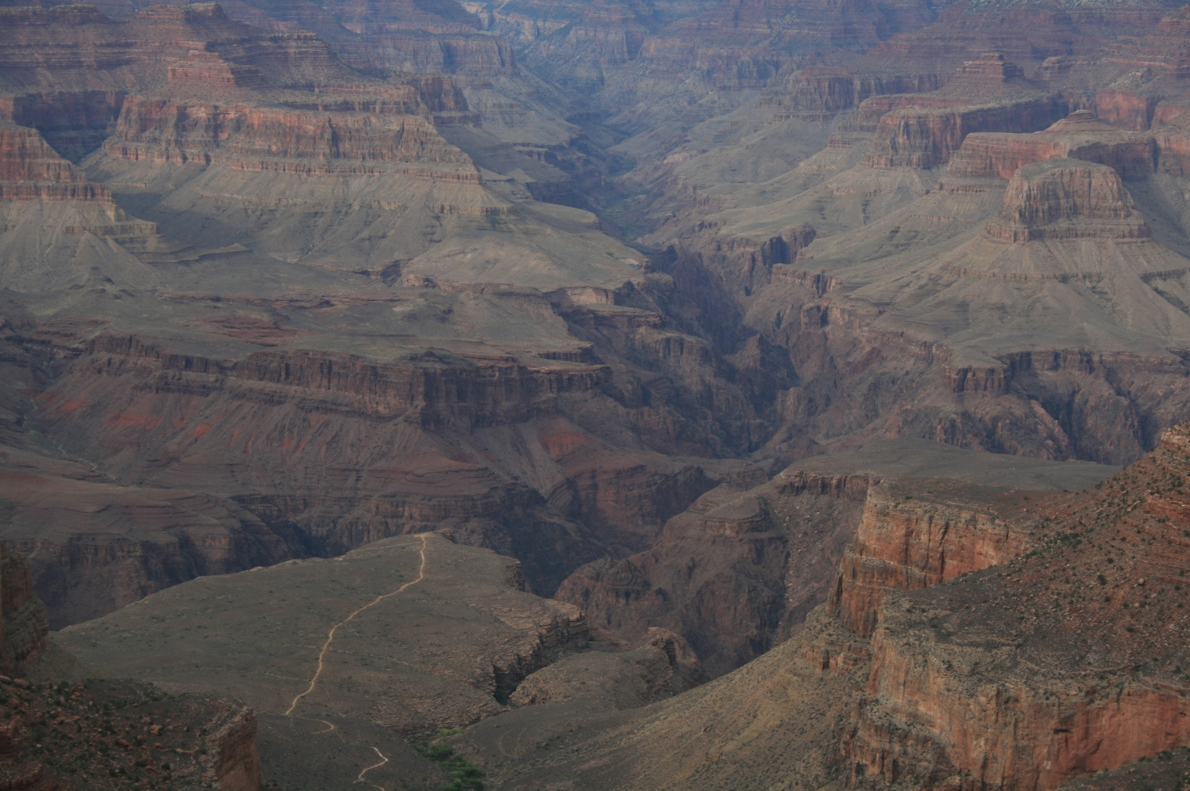
2º ESO
UNIT 1: Forces and movements

Slide 2
Objectives
To know that the motion of an object implicates a change in its position respect to another one that is considered as reference.
To know if an object is moving for a given observer or not.
To know the concepts of: trajectory, position and distance travelled.
To differentiate between position and distance travelled.
To know how to place an object, known the position on the trajectory and the point of reference.
To learn how to calculate the distance travelled, known the position in two moments.
To understand the concept of speed and to know how to calculate the average speed, known the distance travelled and the time interval.
To know how to convert speed measures expressed in km/h to m/s, and in m/s to km/h.
To understand the concept of acceleration and to know how to calculate the average acceleration, known the initial velocity, the final velocity and the value of the time interval.
To know the units of the international system of position, speed, acceleration.
To know how to graph and how to interpret the graphic position-time of an uniform motion, known a data table.
To know how to relate the slope of the graphic position-time of an uniform motion with the speed.
To know the meaning of the concept of force, associating it with the interaction between two objects, and never associating it with something that an object has and to know that forces are responsible for the change of the movement.
To know the differences between weight and mass and to know how to calculate the weight on the Earth's surface, known the mass of an object.
To know that the unit of the international system of force is the Newton (N).

Slide 3
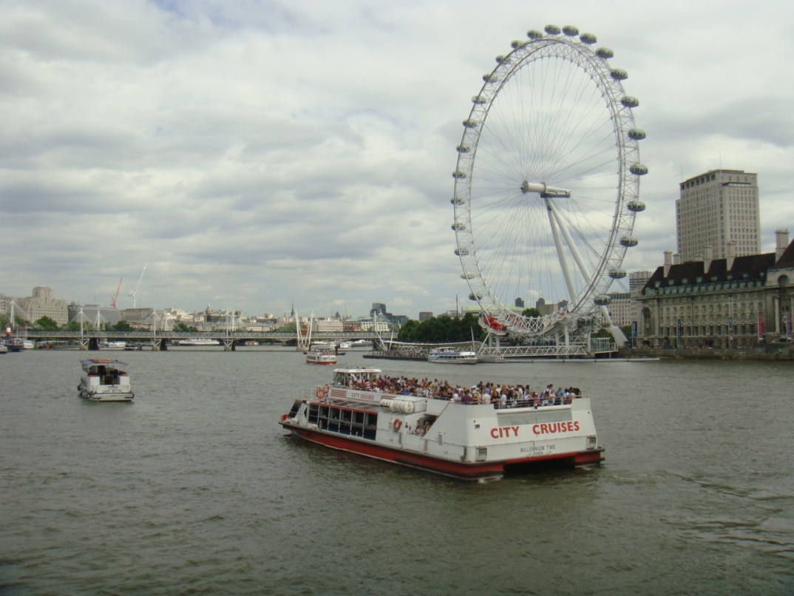
What is the movement?
Everything in the universe moves. It might only be a small amount of a very slow movement, but movement does happen. Don't forget that even if you appear to be standing still, the Earth is moving around the Sun, and the Sun is moving around our galaxy.
We say that an object is moving when it changes its position with respect to another one that we consider as fixed.
It is not possible to say that an object is in motion or rested without a reference to another one.
In physics, motion is the change of location or position of an object with respect to time . Motion is always observed and measured related to a frame of reference.
In fact, for people on the big wheel, the boat moves but to those on the boat, it will be at rest.

Slide 4
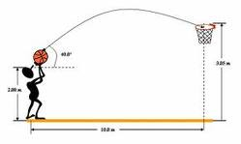
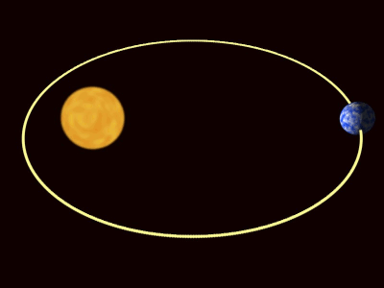
MOTION CHARACTERISTICS
If we want to know how a movement has been it is necessary to know its characteristics. The main characteristics are the following ones: trajectory, position, distance travelled, time taken, speed and acceleration.
Trajectory is the path that a moving object follows through space. It can be rectilinear, circular, elliptical, parabolic, hyperbolic, etc.
A trajectory can be described mathematically either by the geometry of the path, or as the position of the object over time.
The movement of a ball thrown into basket by a basketball player is a parabolic motion.
The movement of the hands of a watch is a circular motion.
The movement of the planets and comets around the Sun is an elliptical motion. An orbit, it would be the path of a planet, an asteroid or a comet as it travels around a central mass.

Slide 5
MOTION CHARACTERISTICS
Position is precisely where an object is located. If we want to describe the movement of a person who is running, we measure the distance from the person to a point that we have taken as reference. This distance is called position and is represented by the letter “s”
Positions on the left of the reference system are often taken as negative and on the right as positive but we can change them if we want.
s₀ is the initial position
1m
s₀
s₁
-
+
s₂
s₃
R
The positions of the ball would be:
s₀ = - 6 m
s₂ = + 3 m
s₁ = - 4 m
s₃ = + 8 m

Slide 6
MOTION CHARACTERISTICS
The distance travelled is equal to the subtraction between two positions, the final position minus the initial position if there is no change in the sense of the movement.
1m
s₀
s₁
-
+
s₂
s₃
R
The distance travelled by the ball from the initial position to the position 3, would be:
distance travelled = s₃ - s₀ = 8 m – (-6 m) = 8 m + 6 m = 14 m
Sometimes, depending on the sense of the movement, the subtraction between the final position and the initial position of an object can be a negative number. However, we will always write the distance travelled as a positive number.
Imagine that the ball goes from the position 3 to the position 2. The distance travelled would be: s₂ - s₃ = + 3 m – 8 m = - 5 m
However, we will say that the distance travelled is 5 m.
The position can be either a positive or a negative number but the distance travelled is always a positive number.

Slide 7
MOTION CHARACTERISTICS
Speed is precisely how fast an object is moving. It is the ratio between the distance travelled and the time elapsed to do it. It is represented by the letter “v”.
s_{final} - s_{initial}
The mathematical expression of the speed is:
v
The SI unit of speed is m/s
t_{final} - t_{initial}
If we want to calculate the speed of an object in a given stretch of a movement, we will divide the distance travelled in this stretch between the elapsed time to traverse it.
1m
s₀
s₁
-
+
s₂
s₃
R
If the ball has taken 2 seconds to go from the initial position to the position 3, the speed of the ball in this stretch would be:
8 m - ( - 6 m)
v
7 m/s
2 s – 0 s
The average speed is the distance travelled per unit time and to calculate it, we have to divide the total distance travelled between the total time elapsed.

Slide 8
MOTION CHARACTERISTICS
If speed does not change in a movement, it is an uniform motion and if it changes in a movement, it is an accelerated motion.
Acceleration is precisely how fast the speed of an object is changing. The acceleration is defined as the ratio between what the speed has changed and the time elapsed to occur that change. It is represented by the letter “a”.
The mathematical expression of the acceleration is:
v_{final} - v_{initial}
a
t_{final} - t_{initial}
The SI unit of acceleration is m/s²
A cyclist accelerates from 0 m/s to 8 m/s in 3 seconds. What is his acceleration ? Is this
acceleration higher than that of a car which accelerates from 0 to 30 m/s in 8 seconds?
v_{final} - v_{initial}
8 m/s – 0 m/s
a _{cyclist}
2,6 m/s²
t_{final} - t_{initial}
3 s – 0 s
v_{final} - v_{initial}
30 m/s – 0 m/s
a _{car}
3,7 m/s²
t_{final} - t_{initial}
8 s – 0 s

Slide 9
GRAPHS OF THE UNIFORM MOTION
“t” is the independant variable and “s” is the dependant variable
In the uniform motion the object travels equal spaces in equal intervals of time. The position-time graph for constant velocity is a straight line.
The graph s/t doesn’t say to us anything about the trajectory
v (m/s)
“t” is the independant variable and “v” is the dependent variable
In the uniform motion the speed is constant. The velocity-time graph for constant velocity is a horizontal line.
t (s)

Slide 10
GRAPHS OF THE UNIFORM MOTION
s (m)
The steeper the straight line is, the faster the movement is
A
B
s_{final} - s_{initial}
v
t_{final} - t_{initial}
t (s)
20 m - 0 m
10 m - 0 m
v_{A}
4 m/s
v_{B}
2 m/s
5 s – 0 s
5 s – 0 s

Slide 11
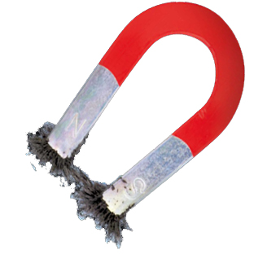
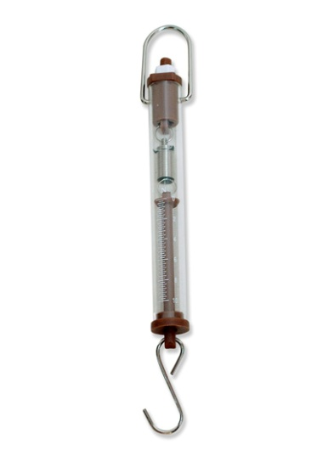
FORCES
Force is a physical magnitude that measures the interaction between two objects. Objects don’t have force. When we speak about a force, there are always two objects.
The SI unit of force is the Newton (N)
The forces that act on objects can deform them or change their speed.
If a magnet is approached to a piece of iron, the magnet exerts a force on it, and the piece of iron exerts a force on the magnet. The two forces are identical but they are applied on different objects and that’s why they produce different effects.
Sometimes, there forces between objects although they are not in contact.
F_{magnet, iron}
We can measure forces with dynamometers.
F_{iron, magnet}

Slide 12
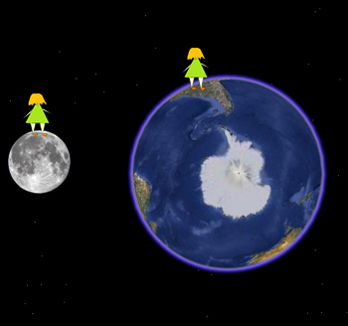
WEIGHT AND MASS
Mass and weight are related but are different properties of an object. Mass is an inherent property while weight is the gravitational force acting on an object. Physicists use the concept of mass to measure the amount of matter an object has and the concept of weight to measure the interaction between two objects. Notice that weight is a force not a mass.
Weight is the gravitational force acting on an object. The weight on Earth's surface is the force which the Earth attracts an object with and at the same time the force which the object attracts the Earth with. Both forces are equal.
When we say that a person weighs 670 Newtons, that means that Earth attracts that person with a force of 670 Newtons .
F_{girl, Earth}
F_{girl, Moon}
F_{Moon, girl}
F_{Earth, girl}

Slide 13
WEIGHT AND MASS
MASS | WEIGHT
It measures the amount of matter. | It measures the interaction between two objects.
The SI unit of mass is the kilogram (kg). | The SI unit of weight (it is a force) is the Newton (N).
The mass of an object doesn’t depend on its location. | Unlike mass, an object’s weight depends on its location. An astronaut will have a different weight, but the same mass, on the Moon, Mars, and other locations because the gravitational force varies.
We can measure it with balances. | We can measure it with dynamometers.

Slide 14
Motion
can be
what can change the speed of objects or can deform them, are the
Uniform motion
Change of position with respect to another one that we consider as fixed.
Speed doesn’t change
Trajectory
Position
Distance travelled
Speed
Acceleration
can be
The acceleration is defined as the ratio between what the speed has changed and the time elapsed to occur that change
It is equal to the subtraction between two positions
Accelerated motion
Rectilinear
Circular
Parabolic
Elliptical
Hyperbolic
It is the ratio between the distance travelled and the time elapsed to do it
It is where an object is located
Speed changes
Forces

Slide 15
EXERCISE 1
If you go northward at 2 km/h for an hour and then, you go southward at 3 km/h for one hour, your displacement is:
5 km to the North.
1 km to the South.
1 km to the North.
5 km to the South.

Slide 16
EXERCISE 2
An athlete can run long distances at 4 metres per second. How far can she run in?
50 seconds
3 minutes
1 hour
2 hours and a half
Remember that in the uniform motion:
Distance travelled = speed x time

Slide 17
EXERCISE 3
Andrew rows at an average speed of 2 metres per second.
How long does it take him to row:
70 m
800 m
1 km and a half
b) How far can Andrew row in:
12 seconds
3 minutes and a half
4 hours
Distance
Speed
Time
Speed x Time
Distance
Distance
Time
Speed

Slide 18
EXERCISE 4
Sally drives for 2 hours and a half at 80 km/h, then drives 130 km at 65 km/h, and finally drives for 30 minutes at 100 km/h.
Calculate the total distance Sally has driven
Calculate the time Sally has taken for the journey
Calculate her average speed for the whole journey
Does it mean that her speed has always been the average speed?

Slide 19
EXERCISE 5
A snail moves 5 m in 2 hours. If it moves at the same speed all the time, calculate:
The time it takes to move 20 m
The distance it would move in 3 hours and a half
The time it takes to move 1 m
The distance it moves in 15 minutes

Slide 20
EXERCISE 6
Judith drives from Plymouth to Southampton, a distance of 260 km, in 4 hours. She then drives from Southampton to London, a distance of 145 km, in 1 hour and 30 minutes. Determine her average speed for each journey.
John can type 960 words in 20 minutes. Calculate his typing speed in:
Words per minute
Words per hour

Slide 21
EXERCISE 7
In all rectilinear and uniform motion:
The graph s/t can, or cannot, be a straight line that passes through the origin.
The graph s/t is a sloping line that passes through the origin.
The graph s/t is a curve that does not pass through the origin.
The graph s/t is a straight line that can, or cannot, pass through the origin.

Slide 22
EXERCISE 8
A car is at rest and at t = 0 s, it is in the origin of the reference system. If it moves with constant acceleration in the positive sense :
Its final velocity is zero.
Its initial position is zero but not its initial speed.
Its initial speed is zero but not its initial position.
Its position and initial speed are both zero.

Slide 23
EXERCISE 9
A car is at rest and accelerates with an acceleration of 5 m/s² during 10 seconds, we can say that:
It has an average speed of 50 m/s.
It travels a distance of 50 m.
Its final speed is 50 m/s.
It travels a distance of 2 m.

Slide 24
EXERCISE 10
The drawing shows the movement of an object; s₀, s₁, s₂, s₃, s₄, s₅ and s₆ are the positions of the object in the moments: t = 0 s, t = 1 s, t = 2 s, t = 3 s, t = 4 s, t = 5 s and t = 6 s, respectively.
-
+
R
5 m
s₀
s₁
s₂
s₃
s₄
s₅
s₆
Make a values table with the data of positions and times.
What speed has the object had in its movement? Express it in m/s and in km/h.
What distance has the object covered from the position, s₁ to the position, s₅?
Draw the graph s/t of this movement.
Is it an uniform motion?, ¿why?
Is it a rectilinear motion?, ¿why?

Slide 25
EXERCISE 11
The graph represents data of positions and times of the movement of an object.
Is it an uniform motion or an accelerated motion? Justify your answer.
The position of the object at 2 seconds from when the movement started. The position of the object at 6 seconds.
Speed at the interval 2-6 seconds.
The position of the object at 4 seconds from when the movement started. The position of the object at 10 seconds.
Speed at the interval 4-10 seconds.
How has the trajectory been?
s (m)
t (s)

Slide 26
EXERCISE 12
The graph represents data of positions and times of the movement of two motorbikes that move with an uniform motion.
s (m)
Calculate the distance travelled by the two motorbikes in five seconds.
Calculate the speed of both motorbikes.
What relationship can be established between the speed of each movement and the slope of its graphs?
A
B
t (s)

Slide 27
EXERCISE 13
The attached graphic represents the graphics, s/t of the movements of two people.
Which one does it move faster?
Are they in the same position at some time? If yes, indicates at what moment.
What distance do they cover in the first five seconds? And in the last five seconds?
Is the trajectory travelled by A, rectilinear or curvilinear?
s (m)
A
B
t (s)

Slide 28
EXERCISE 14
The drawing shows the movement of an object. Each drawn division in the trajectory corresponds to a distance of 5 cm. The times, t₀, t₁, t₂, t₃, t₄, t₅ and t₆, indicate the moment in which the object has passed through these points. These times are expressed in minutes.
t₂ = 6
t₁ = 3
t₆ = 18
t₃ = 9
t₅ = 15
t₀ = 0
t₄ = 12
Make a values table with the data of positions and times.
What speed has the object had in its movement? Express it in m/s and in km/h.
What distance has the object covered from the position, 0 cm to the position, 50 cm?
Draw the graph s/t of this movement.
¿Is it an uniform motion?, ¿why?
¿Is it a rectilinear motion?, ¿why?

Slide 29
EXERCISE 15
The graph represents data of positions and times of the movement of three objects.
s (m)
A
B
C
t (s)
Which one has travelled a greater distance in 20 seconds?
Are they in the same position at some time? If yes, indicates at what moment.
Calculate the average speed of each one in that time.
Indicate which of the movements has been an uniform motion. Explain your answer.
Indicate which of the movements has been an accelerated motion. Explain your answer.

Slide 30
EXERCISE 16
Given the following values tables, answer the following questions.
Values table A
Values table B
s (m) | t (s)
2 | 0
4,5 | 1
7 | 2
9,5 | 3
12 | 4
14,5 | 5
17 | 6
19,5 | 7
22 | 8
24,5 | 9
27 | 10
s (m) | t (s)
0 | 0
2 | 1
5 | 2
9 | 3
14 | 4
20 | 5
27 | 6
35 | 7
44 | 8
54 | 9
65 | 10
Draw the graph s/t of each movement.
Calculate the average speed in the first five seconds for each values table.
Calculate the average speed in the time elapsed from the second five to the second ten for each values table.
Indicate the type of movement represented in each graph.

Slide 31
EXERCISE 17
Complete the following chart:
Remember that for calculating the weight of an object on the Earth, you have to multiply by 9,8 the value of its mass expressed in kilograms.
MASS | WEIGHT
5 g
 | 30 N
3, 2 kg
 | 100 N

Slide 32
EXERCISE 18
Tell if the following affirmations are true or false.
You weigh the same wherever you are.
Two objects with the same mass, weigh always the same.
You have the same mass wherever you are.
Your father has a lot of force.
The SI unit of force is the kilogram (kg).

Slide 33
EXERCISE 19
Unscramble the following words:
aliptelcli _ _ _ _ _ _ _ _ _ _
torib _ _ _ _ _
medtnaoerym _ _ _ _ _ _ _ _ _ _ _
learabvi _ _ _ _ _ _ _ _
tsepe _ _ _ _ _
shtyipics _ _ _ _ _ _ _ _ _
taph _ _ _ _
calbane _ _ _ _ _ _ _
irclucar _ _ _ _ _ _ _ _
ghpcrai _ _ _ _ _ _ _

Slide 34
EXERCISE 20
Revise your vocabulary
Choose a word and fill the blanks below
Position, speed, positive, deform, Speed, distance, ratio, interaction, Acceleration, measures, positions, Mass. Force, changing, negative, motion, final, Trayectory, Weight, position, initial, travelled, fast, physical, force
In physics, …………… is change of location or …………….. of an object with respect to time .
…………………. is the path that a moving object follows through space.
………………. is where an object is located.
The ………………. travelled is equal to the subtraction between two …………….., the ……….. position minus the ………….. position if there is no change in the sense of the movement.
The position can be either a …………….. number or a …………….. number but the distance ………………. is always a positive number.
…………… is precisely how ……… an object is moving. It is the ………. between the distance travelled and the time elapsed to do it.
…………………. is how fast the speed of an object is ………………….. .
………… is a ……………. magnitude that measures the …………….. between two objects.
The forces that act on objects can …………….. them or change their ………….. .
……………. is an inherent property that ……………… the amount of matter.
……………… is the gravitational …………….. acting on an object.

Slide 35
GLOSSARY
Acceleration
Average speed
Balance
Circle
Circular
Dependant variable
Distance travelled
Dynamometer
Ellipse
Elliptical
Final
Force
Frame of reference
Graph
Graphic
Gravitational
Hyperbola
Hyperbolic
Independant variable
Inherent
Initial
Instantaneous speed
Interaction
Location
Mass
Motion
Movement
Orbit
Parabola
Parabolic
Path
Physics
Physicist
Position
Ratio
Rectilinear
Reference point
Reference system
Relative
Speed
Steep
Straight line
Time elapsed
Time taken
To accelerate
To attract
To be at rest
To deform
To elapse
To stand still
Trajectory
Uniform
Velocity
Weight

