Slide 1
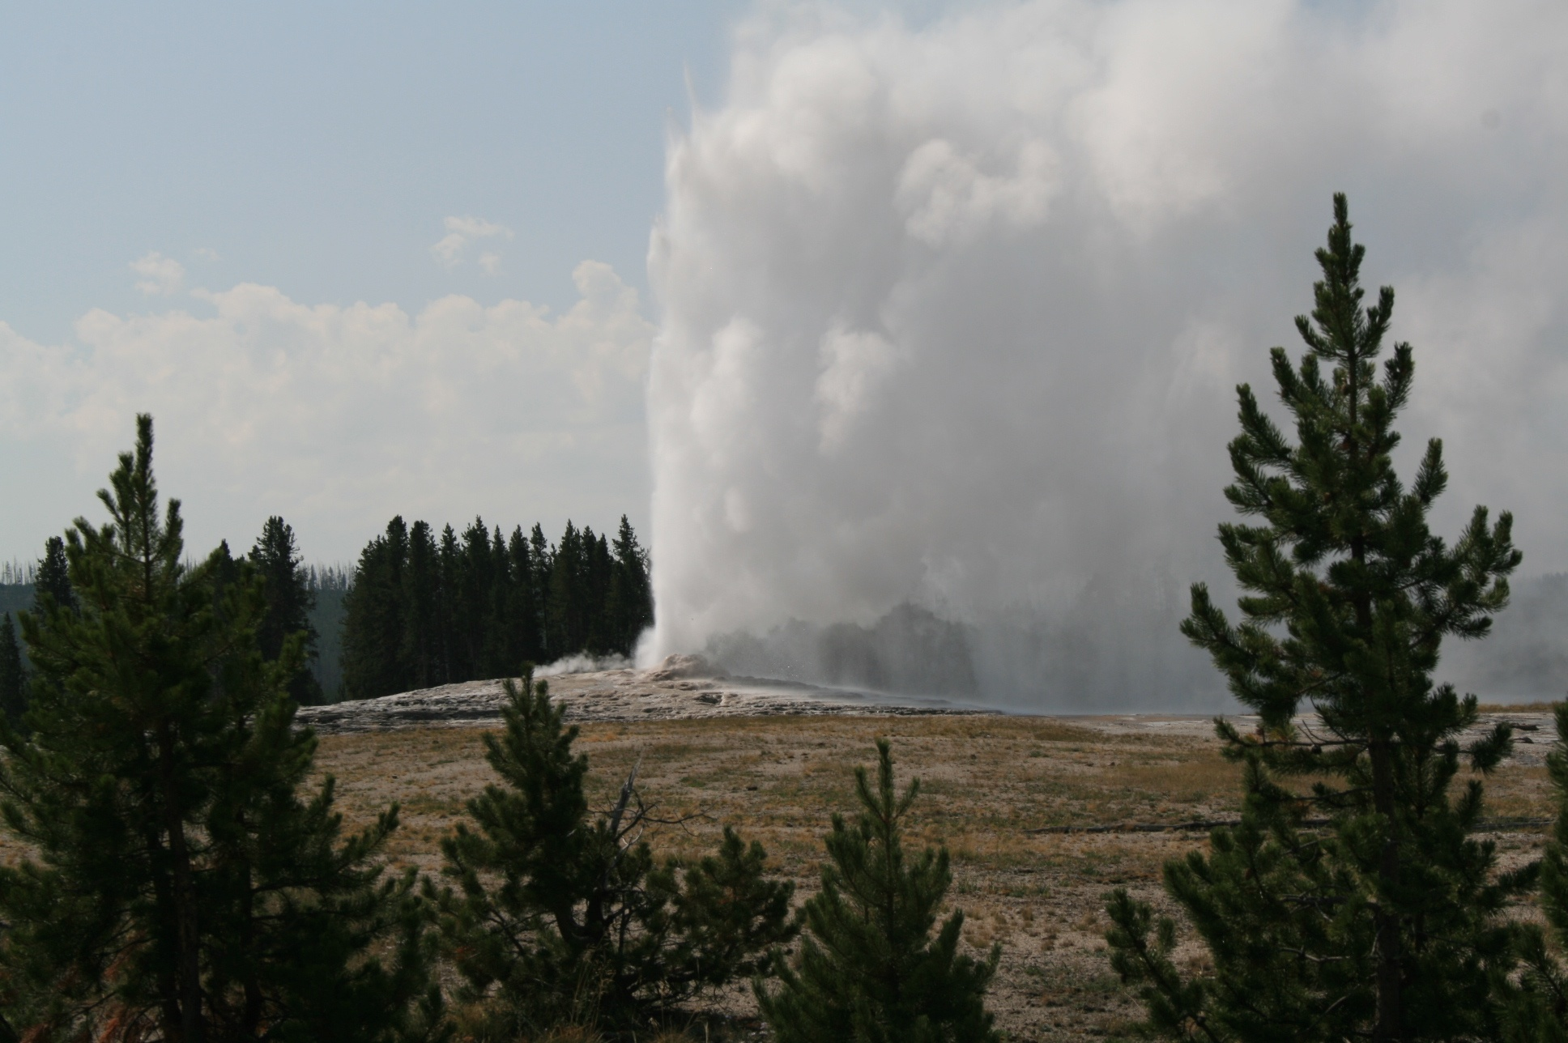
2º ESO
UNIT 2: Energy

Slide 2
Objectives
To know that energy is not something material.
To know that energy is a property of the objects or systems that is related with their ability to produce changes in themselves or in other objects or systems.
To know that the unit of the international system of energy is the Joule (J) and to know that another unit of energy is the calorie (cal) that is equivalent to 4,18 joules.
To know how to calculate the kinetic energy of an object, known its mass and speed.
To know how to calculate the gravitational potential energy of an object, knowing its weight and height.
To know the meaning of calorific value of a fuel.
To know that energy is always the same in any transformation ( it retains), that is, that the sum of the energies of the systems at the beginning of the transformation is equal to the sum of the energies of the systems at the end.
To know how to describe the physical and chemical transformations that systems suffer as well as the changes of energy associated with them.
To know how to apply the principle of conservation of energy in a qualitative manner.
To know that when we use the energy for some process, it loses utility, that is, it degrades.
To know that heat is the energy transferred between two objects or systems due to a difference of temperature between two objects or systems and to know that the objects don’t have heat.
To know that the dilation and contraction processes occur in all the states of matter.
To know the value assigned to fixed points of the Kelvin and Celsius scales.
To know the meaning of thermal conductor and thermal insulator.
To know how to explain the difference between renewable and non renewable energy sources.
To know how to explain how electricity is produced.

Slide 3
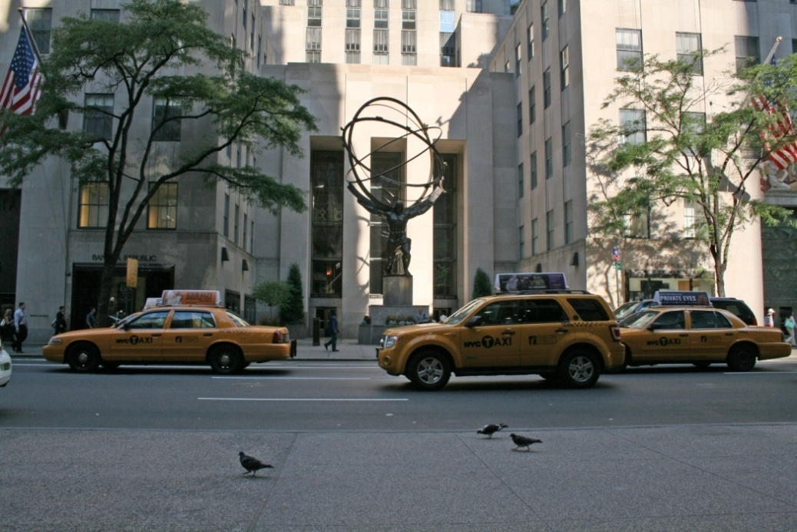
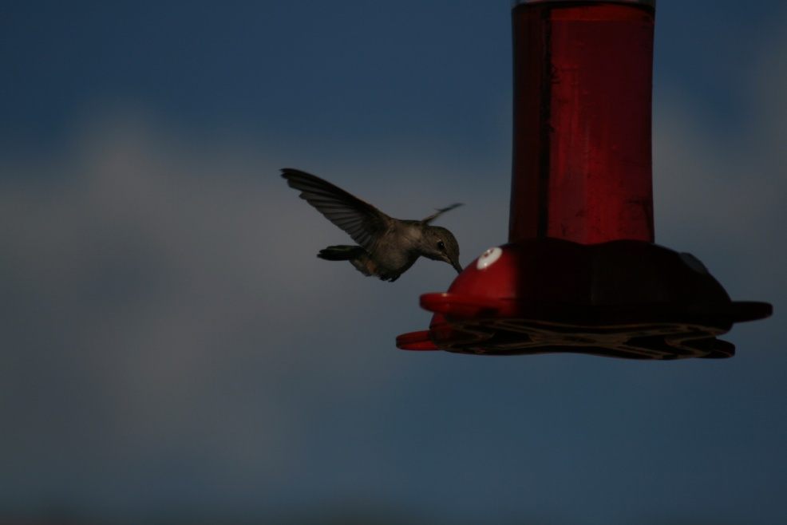
What is energy?
Energy is the ability of objects to produce changes or transformations in themselves or in other objects. We say that something has energy when it has the property of producing changes or transformations.
The petrol has energy and the cars move thanks to this energy.
The hummingbird takes the energy for flying from the energy that there is in the food.

Slide 4
Types of energy
Although energy has always the same meaning, there are diferent types of energy depending on the origin of the ability to produce changes or transformations. Some of these types of energy are the following ones:
Kinetic energy: associated with the movement of objects. If the air is at rest has less energy that if it moves.
Gravitational potential energy: associated with the position of objects. An aeroplane has more energy when it is 1000 m high that when it is at ground level.
Mechanical energy: kinetic energy plus potential energy.
Internal energy: associated with the type of substance, mass and temperature. 1 litre of petrol has more energy than 1 litre of water.
2 litres of water have more energy than 1 litre of water.
1 litre of water at 20 ºC has less energy than 1 litre of water at 60 ºC.
Electrical energy: associated with an electric current.
Luminous energy: associated with the light of the Sun or with the light of any object.
Chemical energy: associated with the absorbed or emitted energy in chemical reactions.
Nuclear energy: associated with the nucleus of atoms.

Slide 5
Units of energy
The unit of energy of the international system is the joule (J). Any form of energy is measured in joules in the international system of units.
Another unit of energy is the calorie (cal). One calorie equals 4,18 joules.
A calorie is the amount of energy required to raise one degree, the temperature of one gram of water
1 cal = 4,18 J

Slide 6
Kinetic energy
The kinetic energy is the energy that objects in motion have.
The kinetic energy of a car that moves at 100 km/h is less than the kinetic energy of a lorry that moves at the same speed due to its capacity to produce changes is lower.
The kinetic energy depends on mass and velocity.
The kinetic energy of a car is greater when it moves at 100 km/h than when it moves at 50 km/h due to its capacity to produce changes is greater.
E_{k}
1
m v²
The mathematical expression of the kinetic energy is:
2
In this expression, the mass has to be measured in kg and the speed in m/s and the resulting kinetic energy will be in joules

Slide 7
Gravitational potential energy
The gravitational potential energy is the energy that an object has due to its position.
The gravitational potential energy depends on weight and height. Unlike mass, an object’s weight depends on its location.
The weight of an object can be calculated by means of the expression:
Weight = mass x g
Where g is the gravity acceleration whose value is 9,8 m/s² on Earth, but it is lower on the Moon.
E_{p}
mgh
The mathematical expression of the gravitational potential energy is:
In this expression, the mass has to be measured in kg, the height in m and the resulting gravitational potential energy will be in joules
The greater the mass and the height are, the greater is the gravitational potential energy.

Slide 8
Internal energy
All objects have internal energy. The internal energy of an object depends on:
Type of substance (chemical composition)
Mass
Temperature
The objects don’t have heat. The objects have internal energy.
One litre of petrol has more energy than one litre of water.
Two litres of water have more energy than one litre of water.
One litre of water at 20 ºC has less energy than one litre of water at 60 ºC.
Some substances as fuels and explosives, have, due to their atomic constitution, a lot of internal energy that is produced by its combustion.
A characteristic of fuels is their calorific value (calorific power), which represents the energy produced by the combustion of 1 kilogram of that fuel
The calorific value of a petrol is 43680 kJ/kg, that means that when 1 kg of that petrol is burned, 43680 kJ of energy are produced.

Slide 9
Degradation and conservation of energy
The type of energy can change or the energy can be transferred from one system to another but energy cannot be created or destroyed.
The type of energy can change when changes in systems happen. On the other hand, a system can increase its amount of energy but only if another system decreases its amount of energy. A system can decrease its amount of energy but only if another system increases its amount of energy. We can’t obtain energy from nothing.
Change of the type of energy: while an object is falling from a certain height, its gravitational potential energy decreases and its kinetic energy, increases.
Transferred energy: when petrol is burned inside the engine of a car, its internal energy is transferred and the car increases its kinetic and internal energy.
Energy degrades when it can’t be used again.
Energy is transformed, cannot be created or destroyed.

Slide 10
Transference of energy: heat
We must not confuse temperature and heat. We speak about temperature to inform of a characteristic of an object and we speak about heat to refer to certain processes of energy transfer.
Heat is the transfer of internal energy between two objects with different temperatures. When two objects at different temperatures come into contact, the temperature of each one changes until both objects have the same. It is said that they have reached the thermal balance. Heat is a process and not something contained in an object.
Temperature is a property that inform us about the thermal state of the objects. The greater the temperature of an object is, the more the internal energy the object has. One litre of water at 20 ºC has less internal energy than one litre of water at 60 ºC.
When we mix cold water and hot water, the cold water increases its temperature (it is heated) while the hot water decreases its temperature (it is cooled), so that at the end both have the same temperature.

Slide 11
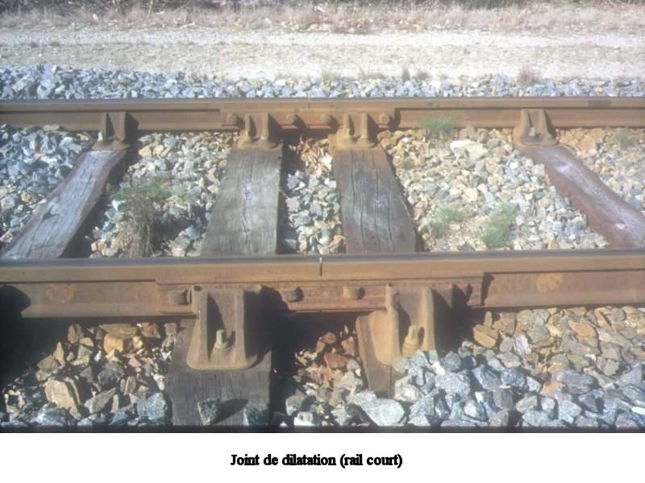
Dilation and contraction
The volume occupied by an object depends on temperature. When the temperature of an object changes, its volume changes. This happens in any state of matter.
Dilation is the increase of volume of an object when its temperature increases.
Contraction is the decrease of volume of an object when its temperature decreases.
Dilatations and contractions of the objects must be taken into account, especially in constructions.
What are dilation joints used for?
They are slots which allow materials to dilate when the temperature increases without breaking the structures.
Almost all the thermometers are based on the dilation of liquid substances.

Slide 12
Thermometers and temperature scales
To measure the temperature of an object we use thermometers, instruments based on thermal balance. In principle, any magnitude which varies with temperature can serve to measure, but the most widely used is the dilation of liquid substances such as mercury or alcohol.
The melting point of ice and the boiling point of liquid water, to one atmosphere of pressure, tend to be the fixed points used to establish the scale that allows us to measure temperatures.
The thermometer is placed within ice when the ice begins to melt, after a time the thermometer and the ice will have the same temperature. When this happens, the height that reaches the thermometric liquid (mercury, alcohol, etc.) is marked. The operation is repeated with boiling water, and again, the height that the thermometric liquid reaches, is marked.
The space between two signals is divided into a number of equal intervals.
Different thermometric scales are obtained depending on the values assigned to the earlier marks. The scales are: Celsius, Kelvin, Fahrenheit.

Slide 13
Thermometers and temperature scales
SCALE | MELTING POINT OF ICE | BOILING POINT OF WATER
CELSIUS | 0 °C | 100 °C
KELVIN | 273 K | 373 K
FAHRENHEIT | 32 ° F | 212 ° F
Absolute zero (0 K) is the temperature when all the particles of a substance stop moving.
To convert degrees Celsius to Kelvin we must add 273.
Tª (K) = Tª (⁰C) + 273
To convert Kelvin to degrees Celsius we must substract 273.
Tª (⁰C) = Tª (K) - 273
To convert degrees Celsius to degrees Fahrenheit, we must multiply by 1,8 and add 32.
Tª (°F) = 1,8 . Tª (⁰C) + 32
To convert degrees Fahrenheit to degrees Celsius, we must subtract 32 and divide by 1.8.
Tª (°C) = (Tª (⁰F) – 32) / 1,8

Slide 14
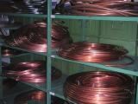
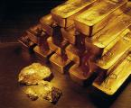
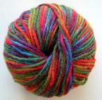
Thermal conductor and thermal insulator
There are materials that allow the heat passage, e.g. metals, while others greatly hinder the passage of heat, e.g. wood and wool. Those who are poor conductors, are called thermal insulator.
A thermal insulator is a material that does not conduct heat well. The reason is that they contain weak molecular bonds in disorderly arrangements. Heat is transfered in a material by the vibration of the atoms and molecules. A disorderly arrangement of particles and bonds slows down the passage of heat through the material.
Most metals are good thermal conductors but the best thermal conductors of all are diamond and carbon nanotubes. The reason for this is that both diamond and carbon nanotubes contains strong molecular bonds in very regular order making it easy for molecular vibrations to travel quickly and efficiently through the materials.

Slide 15
Sensation of cold and heat
The sensations of cold or heat are related to the speed with which energy leaves or enters our body.
To explain properly the sensation of heat and cold, we must take into account two factors:
The difference of temperature between the material that we are going to touch and our body.
The conductivity of the material.
If the material is a good conductor, it favours the passage of energy and the sensation of cold or heat is large.
The sensation of heat or cold depends not only on the temperature of the environment which we are in, but also on the speed of the wind and the temperature and humidity of the air.
A day in which the air temperature is 10 ºC and with wind of 25 km/h, the thermal sensation can be of 0 ºC.

Slide 16
Sources of energy
The sources of energy can be non-renewable or renewable.
The non-renewable sources are limited and cannot be replaced when they run out while the renewable sources can be replaced or used again and they will not run out, at least for now.
The main sources are non- renewable, in particular, fossil fuels: oil, coal and natural gas and uranium.
The environmental problems associated with these sources are well known: pollution, the most discussed problem of global warming and its exhaustion.
Alternative sources are renewable energies such as hydraulic, solar, wind, geothermal, wave, tide, biomass. Unfortunately, renewable energies account for only a few per cent of the global energy consumption. Besides, they are unreliable, intermittent and relatively costly. However, these sources, would allow us to obtain energy without emitting greenhouse gases and also would reduce our dependency on fossil fuels.
Oil means a 50,3 % of the global energy, coal, a 15,2 %, natural gas, a 15,8 %, renewable energies, a 6,8 % and nuclear power, an 11,9 %.

Slide 17
Sources of energy
Sources of energy
can be
Renewable
Non-renewable
They can be replaced or used again and they will not run out for now
They are limited and cannot be replaced when they run out
Hydraulic
Solar
Wind
Geothermal
Wave
Tide
Biomass
Oil
Coal
Natural gas
Uranium

Slide 18
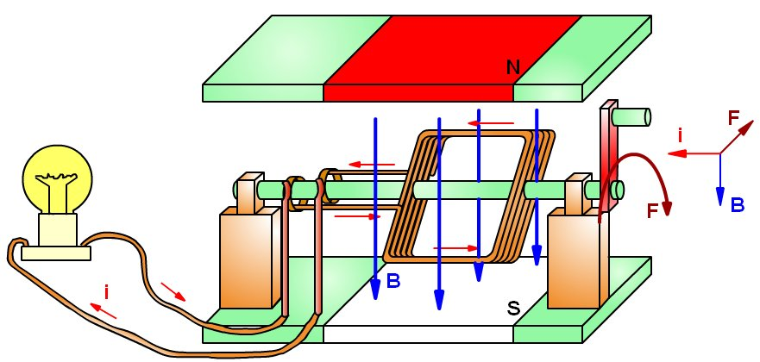
Electrical energy
We have a huge dependence of electrical energy. Refrigerators, washing machines, television, computers, cars, lighting, etc., need electrical energy to work.
A generator is a device that transforms another kind of energy into electrical energy. The most important is the dynamo. The dynamo is a device for converting mechanical energy into electrical energy.
The dynamo bases its operation in the property of producing electricity in a metal strand (wire) when it moves near a magnet or a magnet moves near a metal strand.
Other generators are batteries that transform the internal energy into electrical energy and photovoltaic cells, that transforms luminous energy into electrical energy.
Electricity production is based on getting that a coil turn respect to a magnet in the dynamo, and the way to achieve this, it is what differentiates the various types of power stations or power plants.

Slide 19
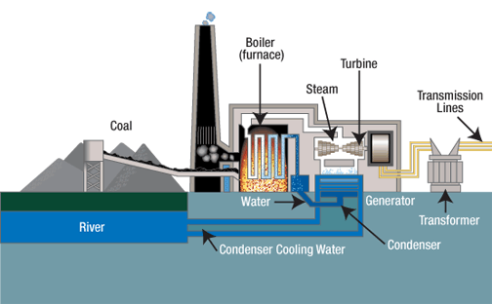
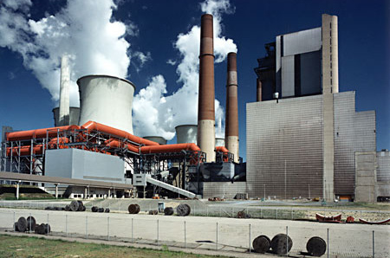
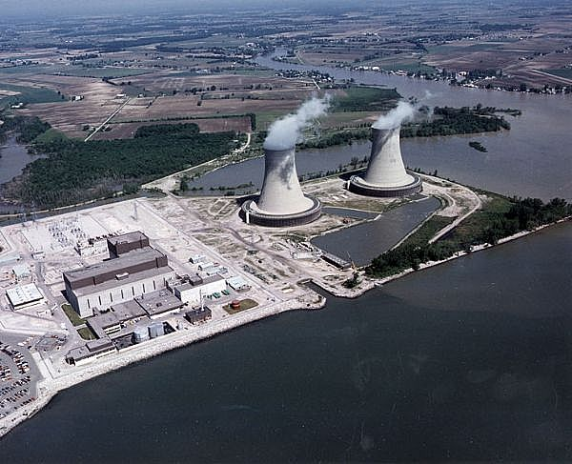
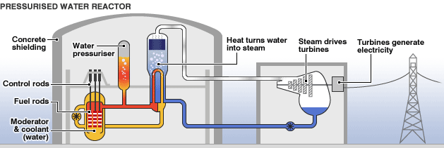
Thermal power plant and nuclear power plant
Thermal power stations burn fuel: oil, coal or natural gas and steam at high pressure occurs. This steam, rotates the blades of a turbine and the turbine rotates the dynamo that produces electrical energy.
Nuclear power plants obtain the energy to produce steam at high pressure, from nuclear processes. From this moment, they works like a thermal power plant.
Fuel rods contain enriched uranium.

Slide 20
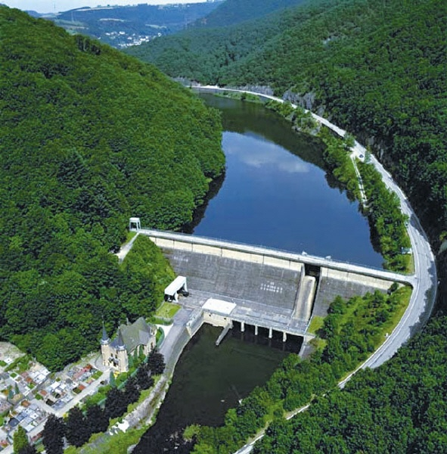
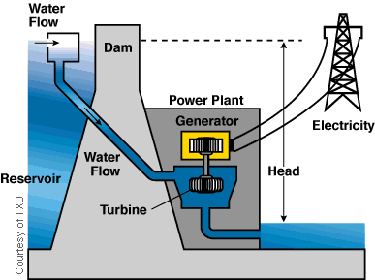
Hydroelectric power plant
Hydraulic energy is the energy that water has that runs through the mountains, streams and rivers. To obtain hydraulic energy, reservoirs are constructed to store the water at a great height.
The gravitational potential energy of the water is transformed into mechanical energy when the turbines blades, placed at the bottom of the dam, are moved by the water. The dynamos are moved by these turbines, producing electrical energy.

Slide 21
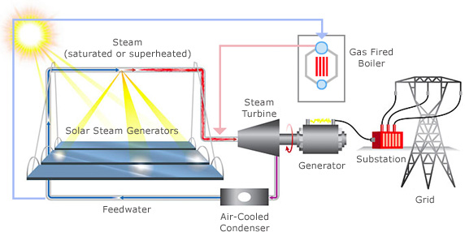
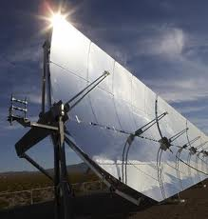
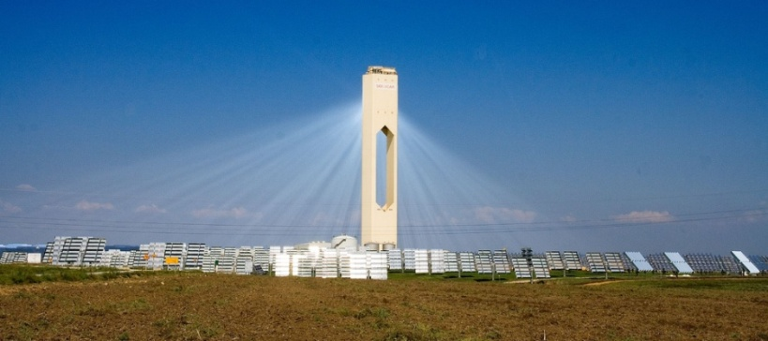
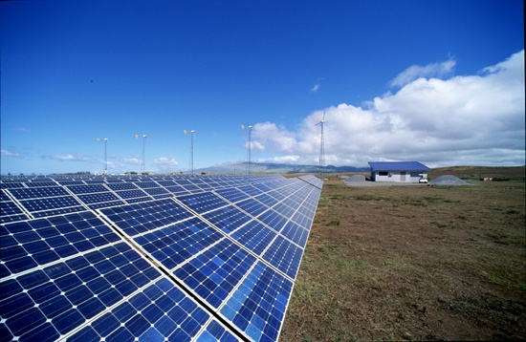
Solar power plant
Although energy from the Sun is also the origin of hydraulic energy, wind or biomass, solar energy is defined as the direct exploitation of the radiation from the Sun. There are two ways to harness this energy: to heat water at low temperature and to produce electrical energy.
There are two ways to produce electricity with solar energy: thermal capture at high temperature and photovoltaic capture.
Photovoltaic capture: photovoltaic panels capture sunlight and transform it directly into electricity. It works as if it was a battery.
Thermal capture: It is to produce steam at high pressure and temperature, concentrating radiation from the Sun. This is done either with flat or parabolic mirrors. The steam is able to move a turbine and produce electricity.

Slide 22
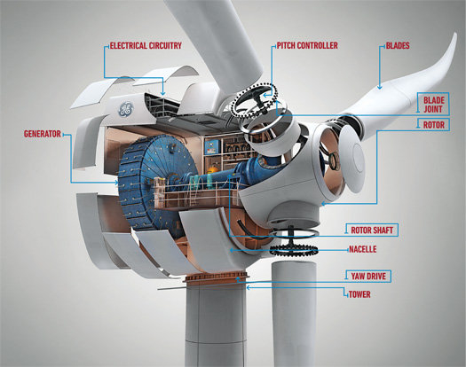
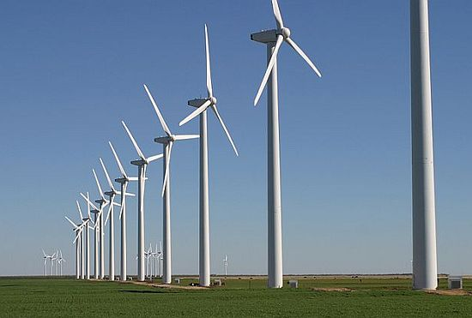
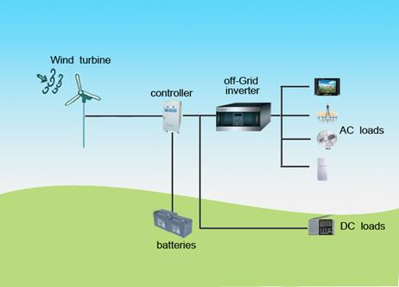
Wind power plant
Wind energy is a source which harness the kinetic energy of the wind to produce electrical energy. Current wind mills are called wind turbines.
The wind rotates the blades of a wind turbine that are mounted on a horizontal axis. This axis is connected to a transmitter of movement which makes to move a generator that produces electricity.

Slide 23
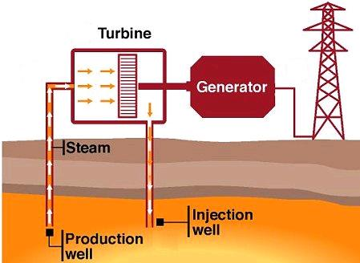
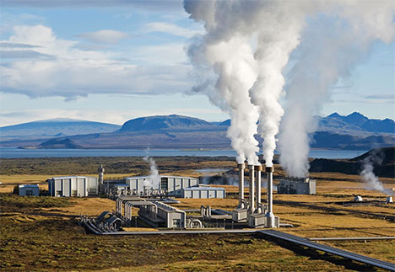
Geothermal power plant
Geothermal energy is the energy associated with the internal energy that there is in the interior of the Earth.
This energy can only be obtained in some places since the differences in temperature must be large to make the exploitation profitable. This is the case of areas with geysers.
Most exploitations are made with two wells, by one, hot water is obtained and by the other, the retrieved flow once it has cooled, is injected into the aquifer.

Slide 24
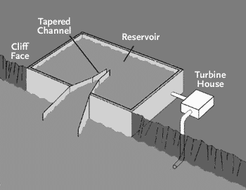
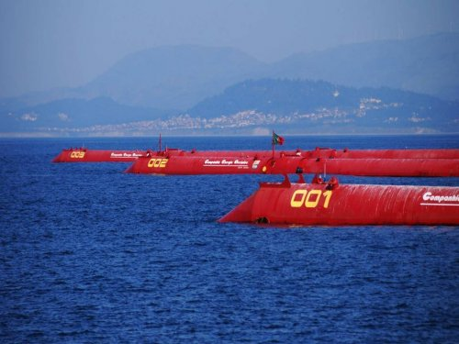
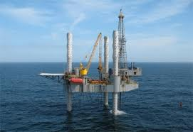
Wave power plant
Ocean wave energy is the energy associated with the kinetic energy of waves. Wave energy plants or wave power plants are commonly known as wave farms. There is tremendous energy in the ocean waves.
There are several methods of getting energy from waves:
Tapered channel: relied on mounted structure in a shore that concentrates the waves and water is stored into an elevated reservoir. The water that flows out of this reservoir is used to generate electricity.
Buoy systems: floating tubes or anchored buoys, rise and fall with the waves. The movement turn a generator and produces electricity.
Oscillating water column: motion of waves at the shore makes that water enter a column and the air that is inside, is forced to turn a turbine.

Slide 25
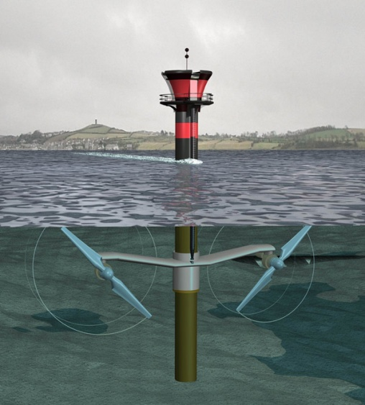
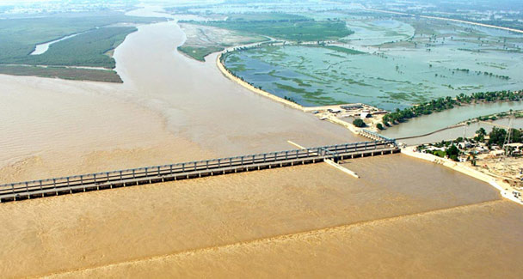
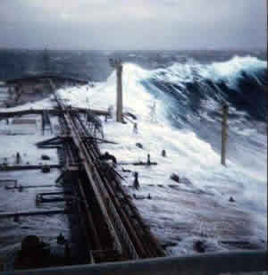
Tidal power plant
The tide moves a huge amount of water twice each day. The sea waters go up and down twice each day. This movement is very large in some places and gives the possibility to harness the kinetic energy of these enormous masses of water.
There are several methods of getting energy from tides:
Tidal stream systems: make use of the kinetic energy of water. Water moves blades of a turbine and turbine rotates a generator, in a similar way to windmills.
Barrages: make use of the potential energy because of the difference in height between high and low tides. They are essentially dams across the full width of an estuary.
Dynamic tidal power: exploits a combination of potential and kinetic energy: by constructing long dams of 30–50 km in length into the sea or ocean.

Slide 26
Energy
Property of objects or systems to produce changes or transformations
Types
It transforms
It transfers
It conserves
It degrades
Sources
Kinetic
Gravitational potential
Mechanical
Internal
Luminous
Electrical
Nuclear
When there is a difference of temperature between two objects
Renewable
Non-renewable
Heat
Oil
Coal
Natural gas
Uranium
Wave
Solar
Wind
Hydraulic
Geothermal
Biomass
Kinetic
Potential
Internal
It depends on mass and speed
It depends on weight and height
It depends on mass, temperature and type of substance
1
E_{k}
m v²
2
E_{p}
mgh

Slide 27
EXERCISE 1
Put the following words in order to form a text with sense
the
changes
has
of
energy
it
Something
or
property
producing
transformations.
when
has

Slide 28
EXERCISE 2
Relate the terms of the two columns
Combustion of a match
A ball to a certain height
A ball moves
Friction between a match and a sandpaper
Internal energy
Potential energy
Chemical energy
Kinetic energy

Slide 29
EXERCISE 3
What types of energy do the following have?
The water in a waterfall
A hot coffee
A jumper who stands on the top of a springboard
A burning log
An arrow when it has been shot
Ocean waves
A high jumper who is running before leaving the ground
A plane is 3000 metres high

Slide 30
EXERCISE 4
What changes of energy occur in each of the following cases? Relate the terms of the two columns
Dynamo of a bicycle
A bulb
An iron
A loudspeaker
A fan
A photovoltaic panel
A. Mechanical energy Electrical energy
B. Electrical energy Luminous energy
C. Luminous energy Electrical energy
D. Electrical energy Internal energy
E. Electrical energy Acoustic energy
F. Electrical energy Mechanical energy

Slide 31
EXERCISE 5
What changes of energy occur in each of the following cases?
The washing machine starts turning
Butane gas burns
A stone falls from a certain height
Petrol burns and a car moves
A crane lifts a load of bricks
A thunder crashes
A. …………. energy …………. energy
B. …………. energy …………. energy
C. …………. energy …………. energy
D. …………. energy …………. energy
E. …………. energy …………. energy
F. …………. energy ………… energy

Slide 32
EXERCISE 6
Calculate the kinetic energy of a 45 g golf ball travelling at:
20 m/s
216 km/h
40 m/s
36 km/h
E_{k}
1
m v²
2
mass in kilograms
speed in metres/seconds

Slide 33
EXERCISE 7
A 50 kg bicyclist on a 10 kg bicycle speeds up from 5 m/s to 10 m/s.
What was the total kinetic energy before accelerating?
What was the total kinetic energy after accelerating?

Slide 34
EXERCISE 8
What is the gravitational potential energy of a 61.2 kg person standing on the roof of a 10-storey building relative to:
Each storey is 2.50 m high
The tenth floor
The sixth floor
The first floor
E_{p}
mgh
mass in kilograms
g = 9,8 m/s²
height in metres

Slide 35
EXERCISE 9
A plane is flying at 720 km/h and is 4000 metres high.
What is its kinetic energy?
What is its gravitational potential energy?
What is its mechanical energy?
Remember that the mechanical energy is the kinetic energy plus the potential energy

Slide 36
EXERCISE 10
Choose a word and fill the blanks below
32, 100, 273, 373, melting, solid, ice, liquid, boiling, gaseous
The ……………………. point of water is:
0 °C (degrees Celsius) = …… K (Kelvin) = …… °F (degrees Fahrenheit). Below 0 ºC water remains in …………….. state, which it means it is as …….. .
The ……………… point of water is:
……. °C (degrees Celsius) = ……. K (Kelvin) = 212 °F (degrees Fahrenheit). Water remains in ………………. state between 0 °C and 100 °C and if water is at more than 100 ºC is in ………………. state.

Slide 37
EXERCISE 11
Complete the following chart. Remember that:
Tª (K) = Tª (⁰C) + 273
Tª (°F) = 1,8 . Tª (⁰C) + 32
Temperature (°C) | Temperature (K) | Temperature (°F)
20
 | 100
 |  | 36
- 10

Slide 38
EXERCISE 12
At how many degrees Celsius don’t the atoms move?
As a substance heats up , the particles start to move around more quickly and the temperature rises . So the temperature measures the average kinetic energy of the particles in a substance
At 0 ºC
At 273 K
At – 273 ºC
That cannot happen

Slide 39
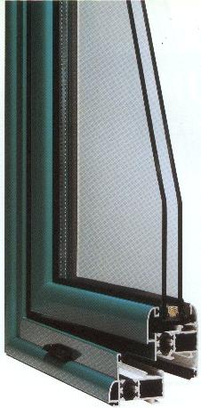
EXERCISE 13
Why is the double glazing so useful to insulate thermally the houses?
Because the two panes do not conduct heat well.
Because the pane has a thermal conductivity much lower than air
Because the air is very bad thermal conductor
Because the air is a very good thermal conductor

Slide 40
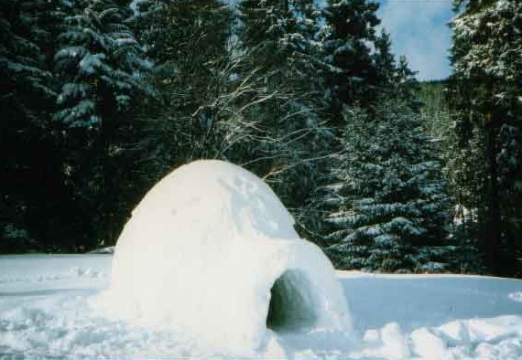
EXERCISE 14
Why is heat retained in the interior of an inhabited igloo?
Because the ice is a bad thermal insulator
Because the ice is a good thermal conductor
Because the ice has a low thermal conductivity
Because it has reached the thermal equilibrium with the outside

Slide 41
EXERCISE 15
Tell if the following affirmations are true or false.
The objects have heat
When energy is spent, the energy is lost
Energy is a material substance
All matter has internal energy
Heat and temperature are more or less the same
The cooler substance tranfers internal energy to the warmer one

Slide 42
EXERCISE 16
Select only those items that are examples of renewable sources of energy
Coal
Wind
Natural gas
Tidal
Geothermal
Fossil fuels
Hydroelectric
Oil
Biomass
Solar
Uranium
Wave

Slide 43
EXERCISE 17
You can see in the graphic, the detail of consumption of different sources of energy in Spain during 2009. Use the bar chart to answer the following questions:
Which fossil fuels have been used in Spain?
What percentage of Spain’s energy consumption is from renewable sources?
What percentage of Spain’s energy consumption is from non-renewable sources?
What is bagasse?

Slide 44
EXERCISE 18
Relate the terms of the two columns
Internal heat of Earth
Sun
Natural gas
Coal
Oil
Wind
Reservoirs
Tides
Non-renewable energy, liquid fossil fuel
Wind energy
Geothermal energy
Non-renewable energy, solid fossil fuel
Tidal power
Non-renewable energy, gaseous fossil fuel
Solar energy
Hydroelectric energy

Slide 45
EXERCISE 19
Unscramble the following words:
wbreaenel _ _ _ _ _ _ _ _ _
rwpeo _ _ _ _ _
vyraigt _ _ _ _ _ _ _
larucen _ _ _ _ _ _ _
nseshar _ _ _ _ _ _ _
gnreadaodti _ _ _ _ _ _ _ _ _ _ _
inerhd _ _ _ _ _ _
alntp _ _ _ _ _
rnuietb _ _ _ _ _ _ _
ytebatr _ _ _ _ _ _ _

Slide 46
EXERCISE 20
Revise your vocabulary
Choose a word and fill the blanks below
volume, electrical, changes, non-renewable, Potential, unit, joule, dynamo, renewable, kinetic, mass, gravitational, weight, height. Heat, temperatures, movement , decrease, mechanical, Energy
……………… is the ability of objects to produce ………….. or transformations in themselves or in other objects
Kinetic energy is the energy associated with the ……………... of the objects.
The ……………….. energy depends on ………….. and velocity.
…………………. energy is the energy associated with the position of the objects.
The ……………... potential energy depends on ………… and ………….. .
The ………… of energy of the international system is the ....................... .
………… is the transfer of internal energy between two objects with different …………………………. .
Dilation is the increase of …………. of an object when its temperature increases.
Contraction is the ……............. of volume of an object when its temperature decreases.
The sources of energy can be ………………………. or …………………………… .
A generator is a device that transforms another kind of energy into ……………. energy. The most important is the ………………. , it is a device for converting …………………. energy into electrical energy.

Slide 47
GLOSSARY
Renewable
Scale
Solar
Thermal
Thermal conductor
Thermal insulator
Tidal
Tide
Transference
To harness
To hinder
To rotate
To transfer
To turn
Uranium
Wave
Wind
Wind turbine
Bagasse
Bar chart
Battery
Biomass
Calorie
Calorific value
Capture
Coal
Conservation
Contraction
Degradation
Dilation
Electrical
Energy
Equilibrium
Fan
Fossil fuel
Geothermal
Gravitational
Gravity acceleration
Hydraulic
Hydroelectric
Internal
Joule
Kinetic
Luminous
Mechanical
Natural gas
Non-renewable
Nuclear
Oil
Petrol
Photovoltaic
Plant
Potential
Power

